Slide 1
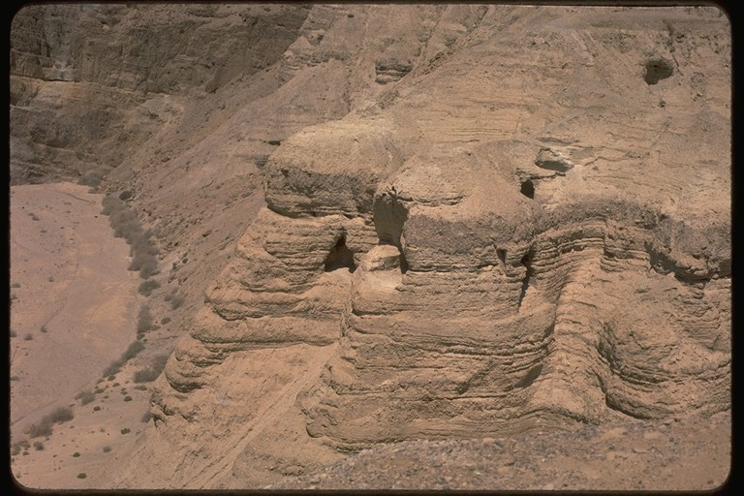
Dead Sea Scrolls
By
Dr. Stephen C Meyers
Institute for Biblical & Scientific Studies
www.bibleandscience.com

Slide 2
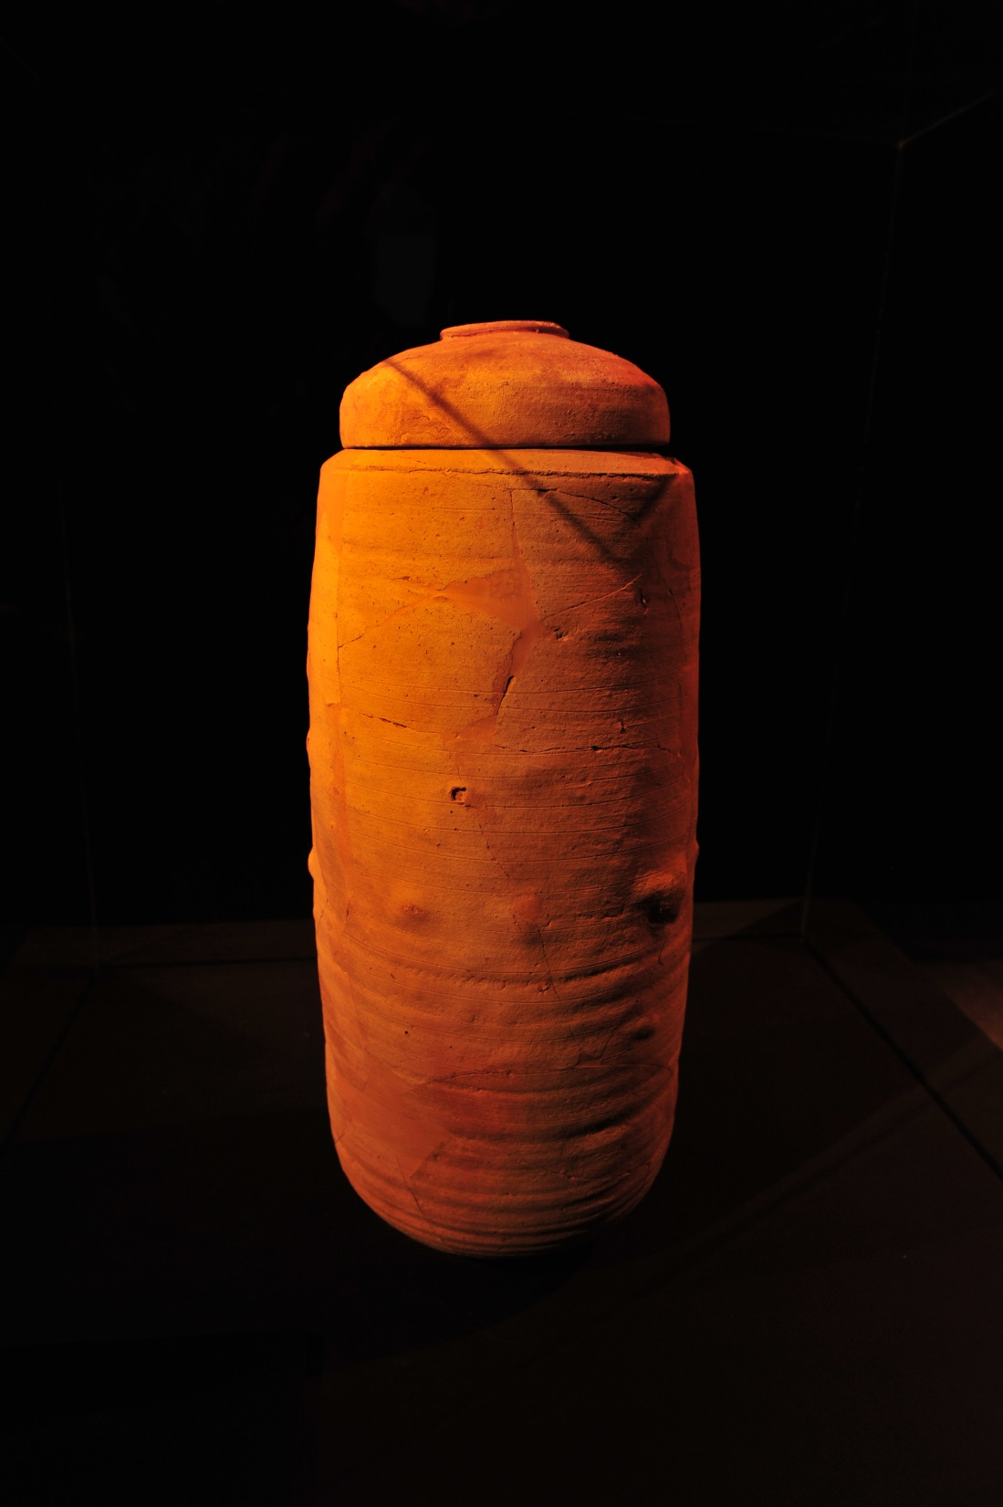
Greatest discovery
in Biblical history
Almost 900 scrolls were discovered. Fragments from all the books of the Old Testament (Tanakh) except Esther.

Slide 3
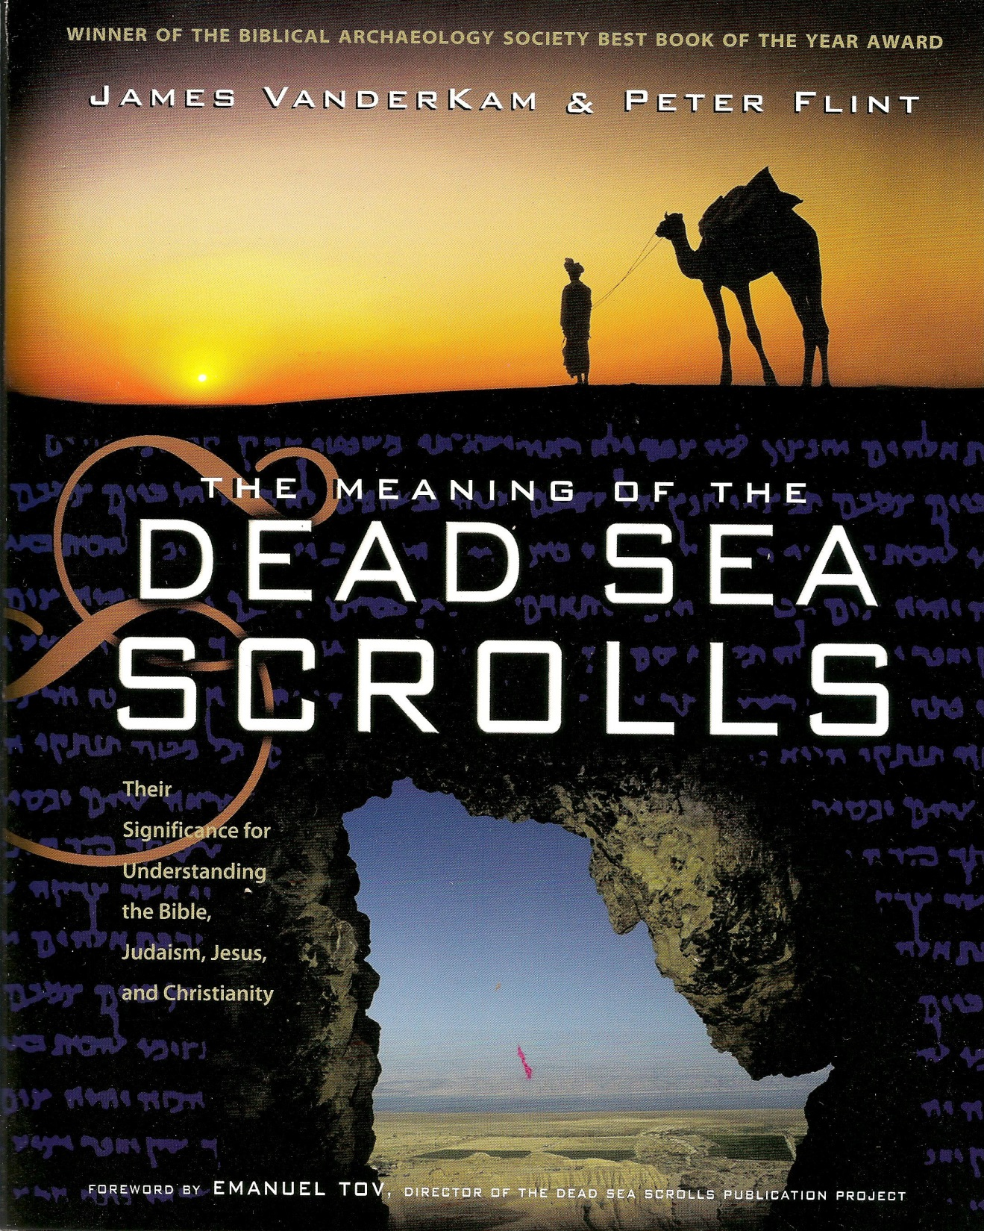
Textbook for this course is The Meaning of the Dead Sea Scrolls by James VanderKam & Peter Flint.

Slide 4
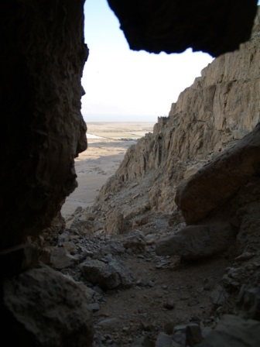
Outline
Discovery
Background
Manuscripts
DSS Texts
Summary
Resources
Key Abbreviations
MT = Masoretic Text or Hebrew Text
LXX = Septuagint or Greek translation
SP = Samaritan Pentateuch or Paleo-Hebrew Text
DSS = Dead Sea Scrolls

Slide 5
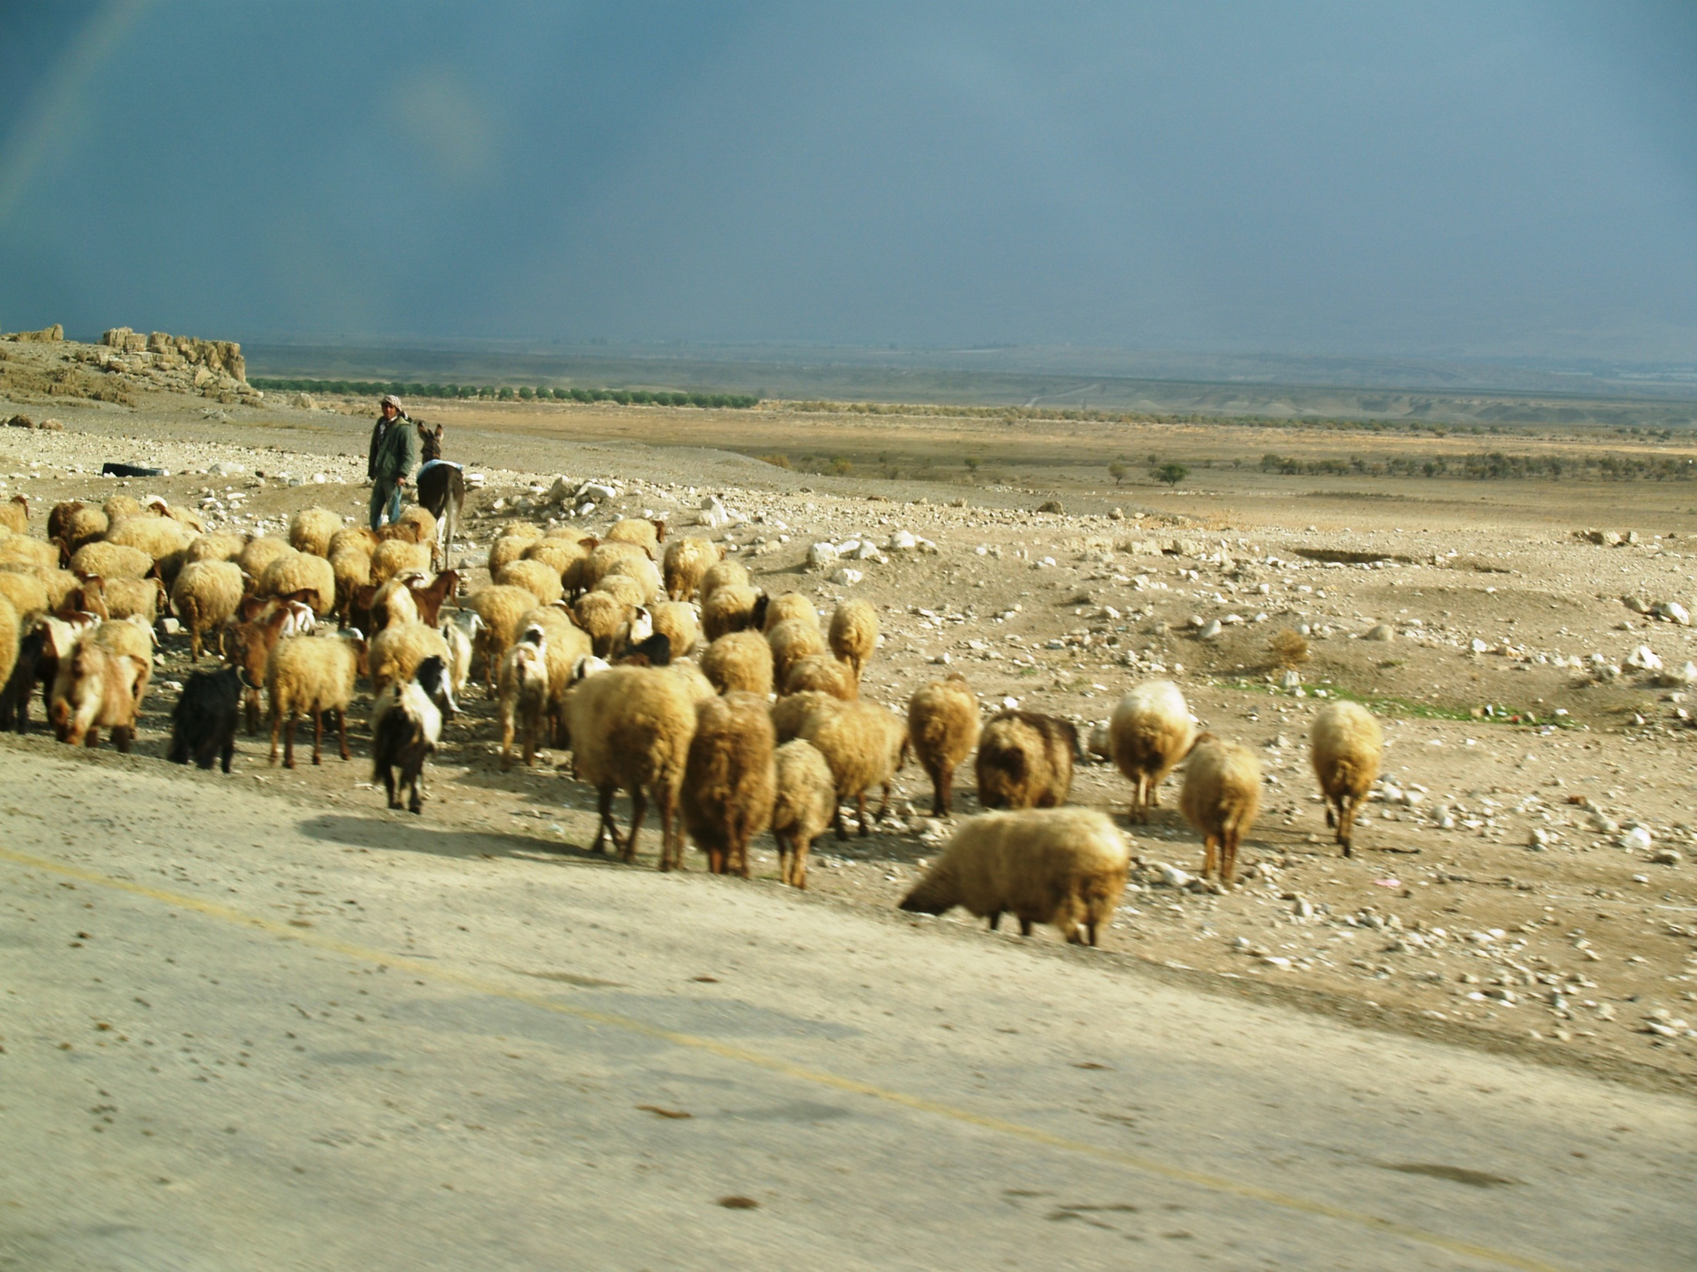
Discovery
In 1946 a Bedouin shepherd boy who constantly was looking for treasure in different caves, saw an opening in the rocks. He threw a stone into the cave, and heard something break. Two days later he went back to investigate, and found large jars with scrolls in them.

Slide 6
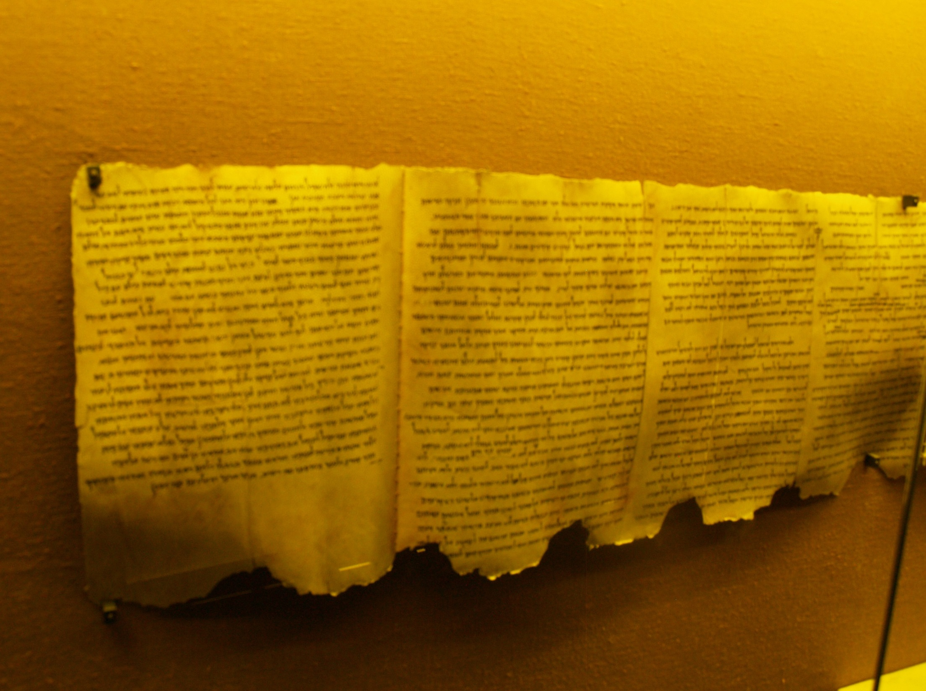
Dating the Scrolls
Paleography
Investigates the styles of ancient handwriting as it chances over time.
Carbon 14 Dating
Accelerator Mass Spectrometry Testing (AMS)

Slide 7
Dating Results
Paleography
Period
Archaic (250-150 BC)
Archaic to Hasmonean (200-150 BC)
Hasmonean (150-50 BC)
Transition to Herodian (75-1 BC)
Herodian (30 BC to 68 AD)
Number of Manuscripts
21 manuscripts
20 manuscripts
224 manuscripts
5 manuscripts
418 manuscripts
From The Meaning of the Dead Sea scrolls.

Slide 8

Numbering the Scrolls
1QIsa(a): the number 1 means it is from Cave 1, Q means from Qumran, Isa stands for Isaiah, and the subscript is letter assigned to this text (a for the first Isaiah scroll found, b for the second one and so on). This is the Great Isaiah Scroll.
4Q53 (Samc): This means from cave 4, Qumran, fragment 53 which is from the book of Samuel third fragment (c).

Slide 9
Dating Results
Carbon 14
Dead Sea Scroll Text
1QIsa(a)Great Isa Scroll
1QapGen Genesis Ap.
1QpHab Habakkuk
4Q53 (Samc) Samuel
4Q22 (paleo Exm)
AMS Dates
201-93 BC
47 BC-48 AD
88-2 BC
196-47 BC
116 BC- 48 AD
From The Meaning of the Dead Sea scrolls

Slide 10
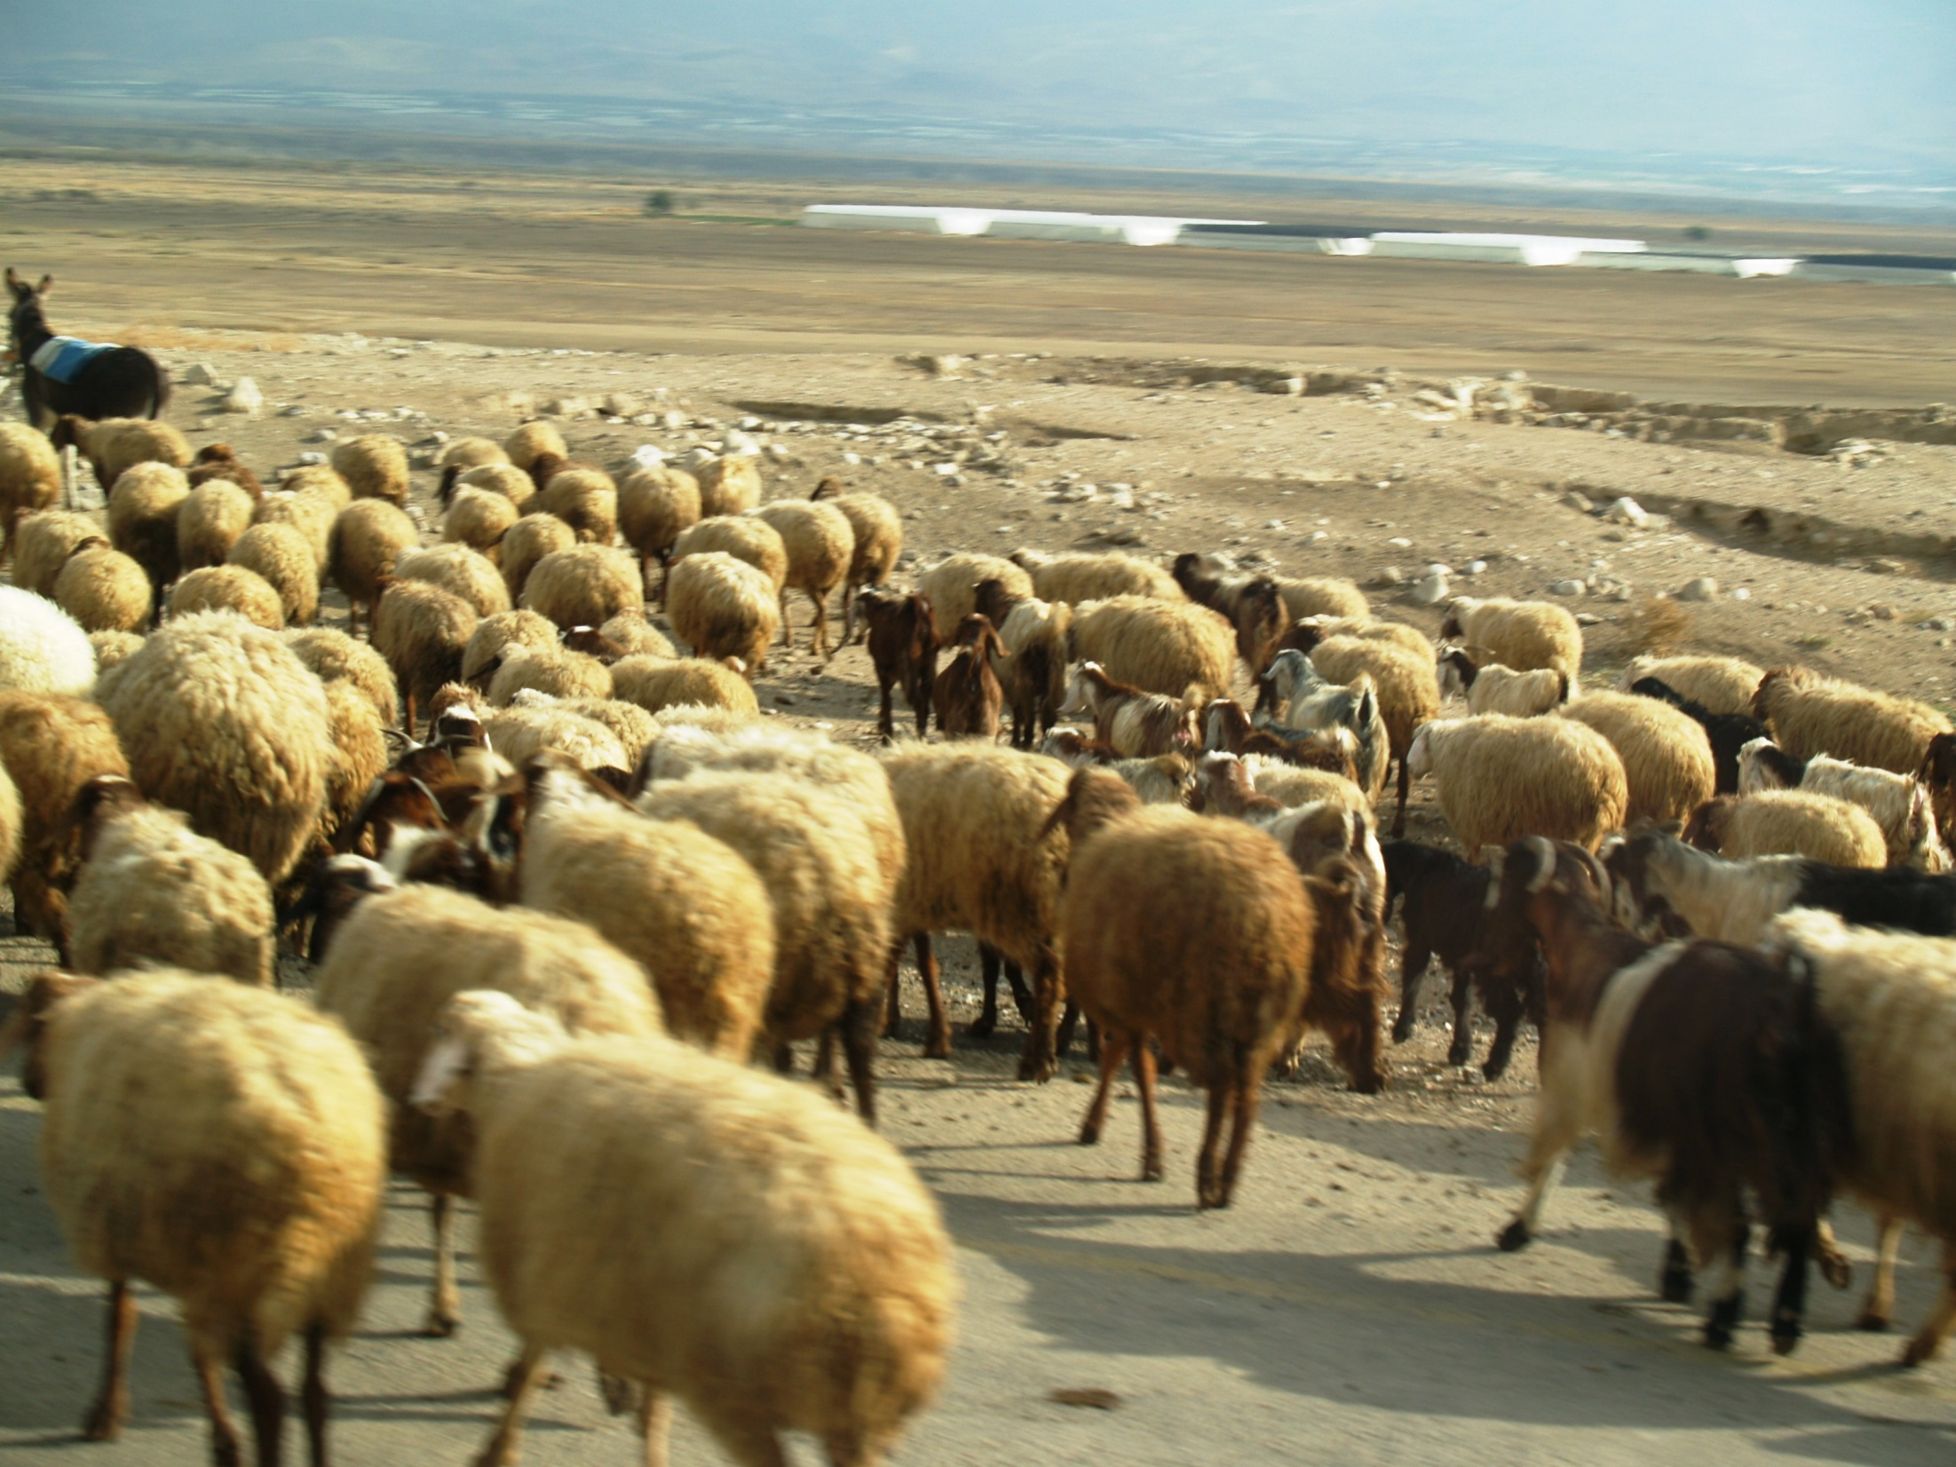
DNA
Testing
Because many of the scrolls are written on parchment (animal skins) they can be DNA tested to try to match fragments, and find their origin and production of individual scroll. Most are goat and sheep skins. Large scrolls like the Isaiah scroll is made from more than one animal.

Slide 11
Digital Imaging
Images of the Dead Sea Scrolls are now available online at http://www.deadseascrolls.org.il/home
Key Website: Orion Center for the Study of the Dead Sea Scrolls and Associated Literature.
http://orion.mscc.huji.ac.il

Slide 12
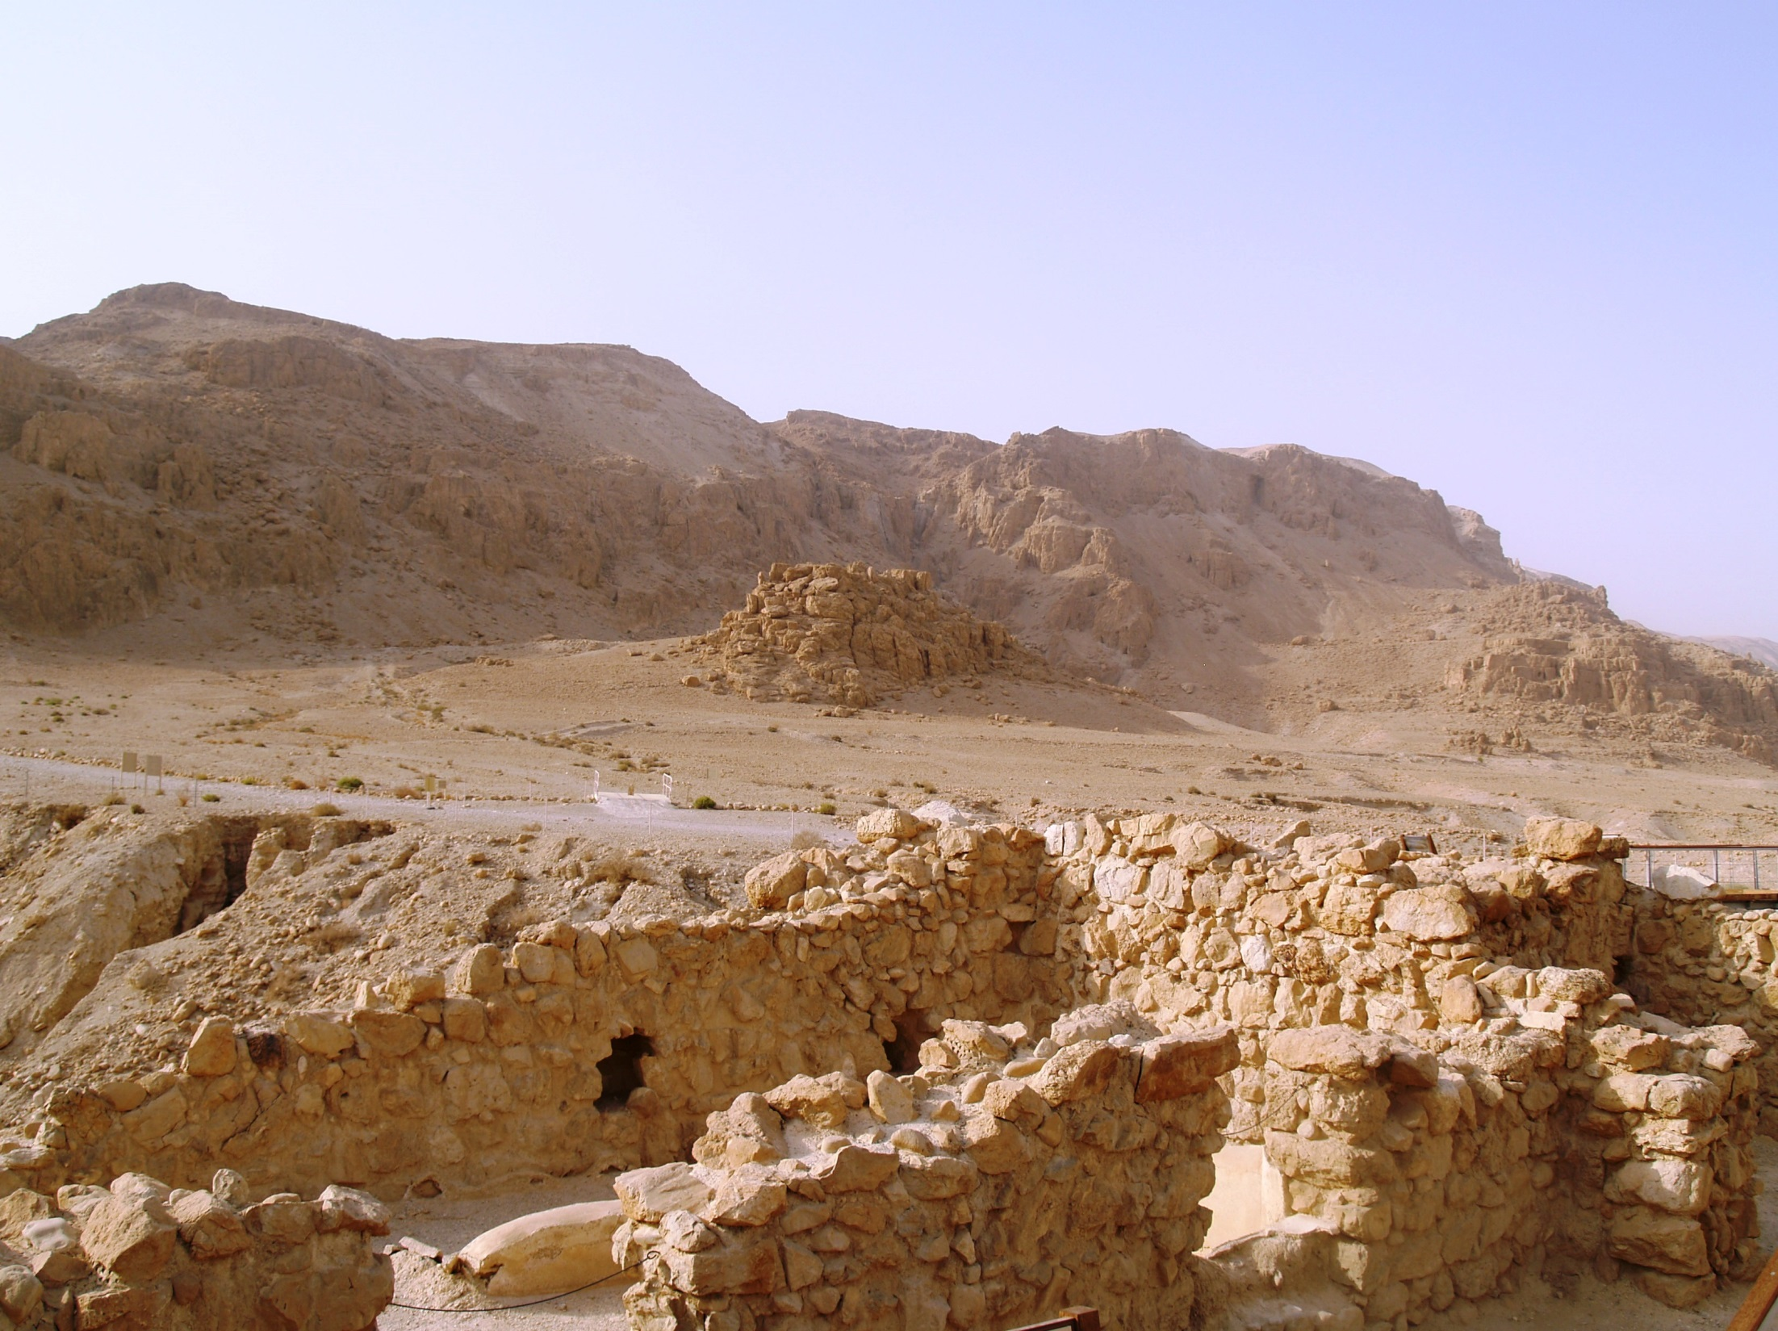
Qumran Community
Qumran, eight and a half miles south of Jericho, is right near the Dead Sea, and the caves where the scrolls were found. Many think the Qumran community stored their scrolls in the caves. Many identify the community at Qumran with the Essenes mentioned by Josephus and Philo. They had very strict rules. Celibacy, common property, ritual purity, and separation from the world were practiced. They wrote their own Biblical commentaries, hymns, rules, and apocalyptic writings. They believed that The Teacher of Righteousness would come soon, and God would destroy the evil in the world. In 68 BC the Roman destroyed Qumran.

Slide 13
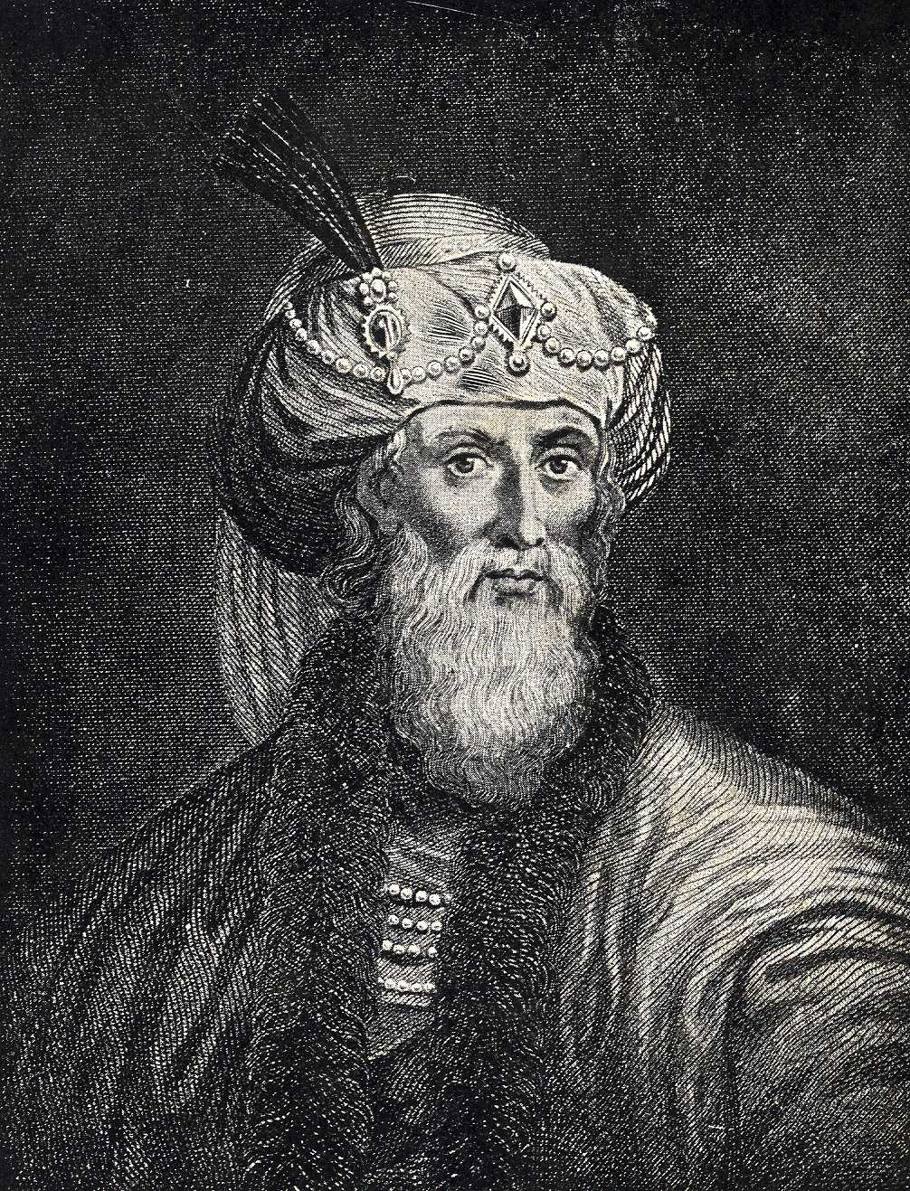
Josephus
There are three accounts of the Essenes in Josephus. There is History of the Jewish Wars 2. 8. 2-13; Jewish Antiquities 13.5.9 and 18.1.5. Josephus compared the Essenes to Pythagorus, the Pharisees to the Stoics and the Sadducees to the Epicureans.
The Essenes led a strictly communal life similar to later Christian monastic living. Many of the Essene groups appear to have been celibate. They had customs such as collective ownership, electing a leader to attend to the interests of the group, obedience to the orders from their leader. Also, they were forbidden from swearing oaths and from sacrificing animals.

Slide 14
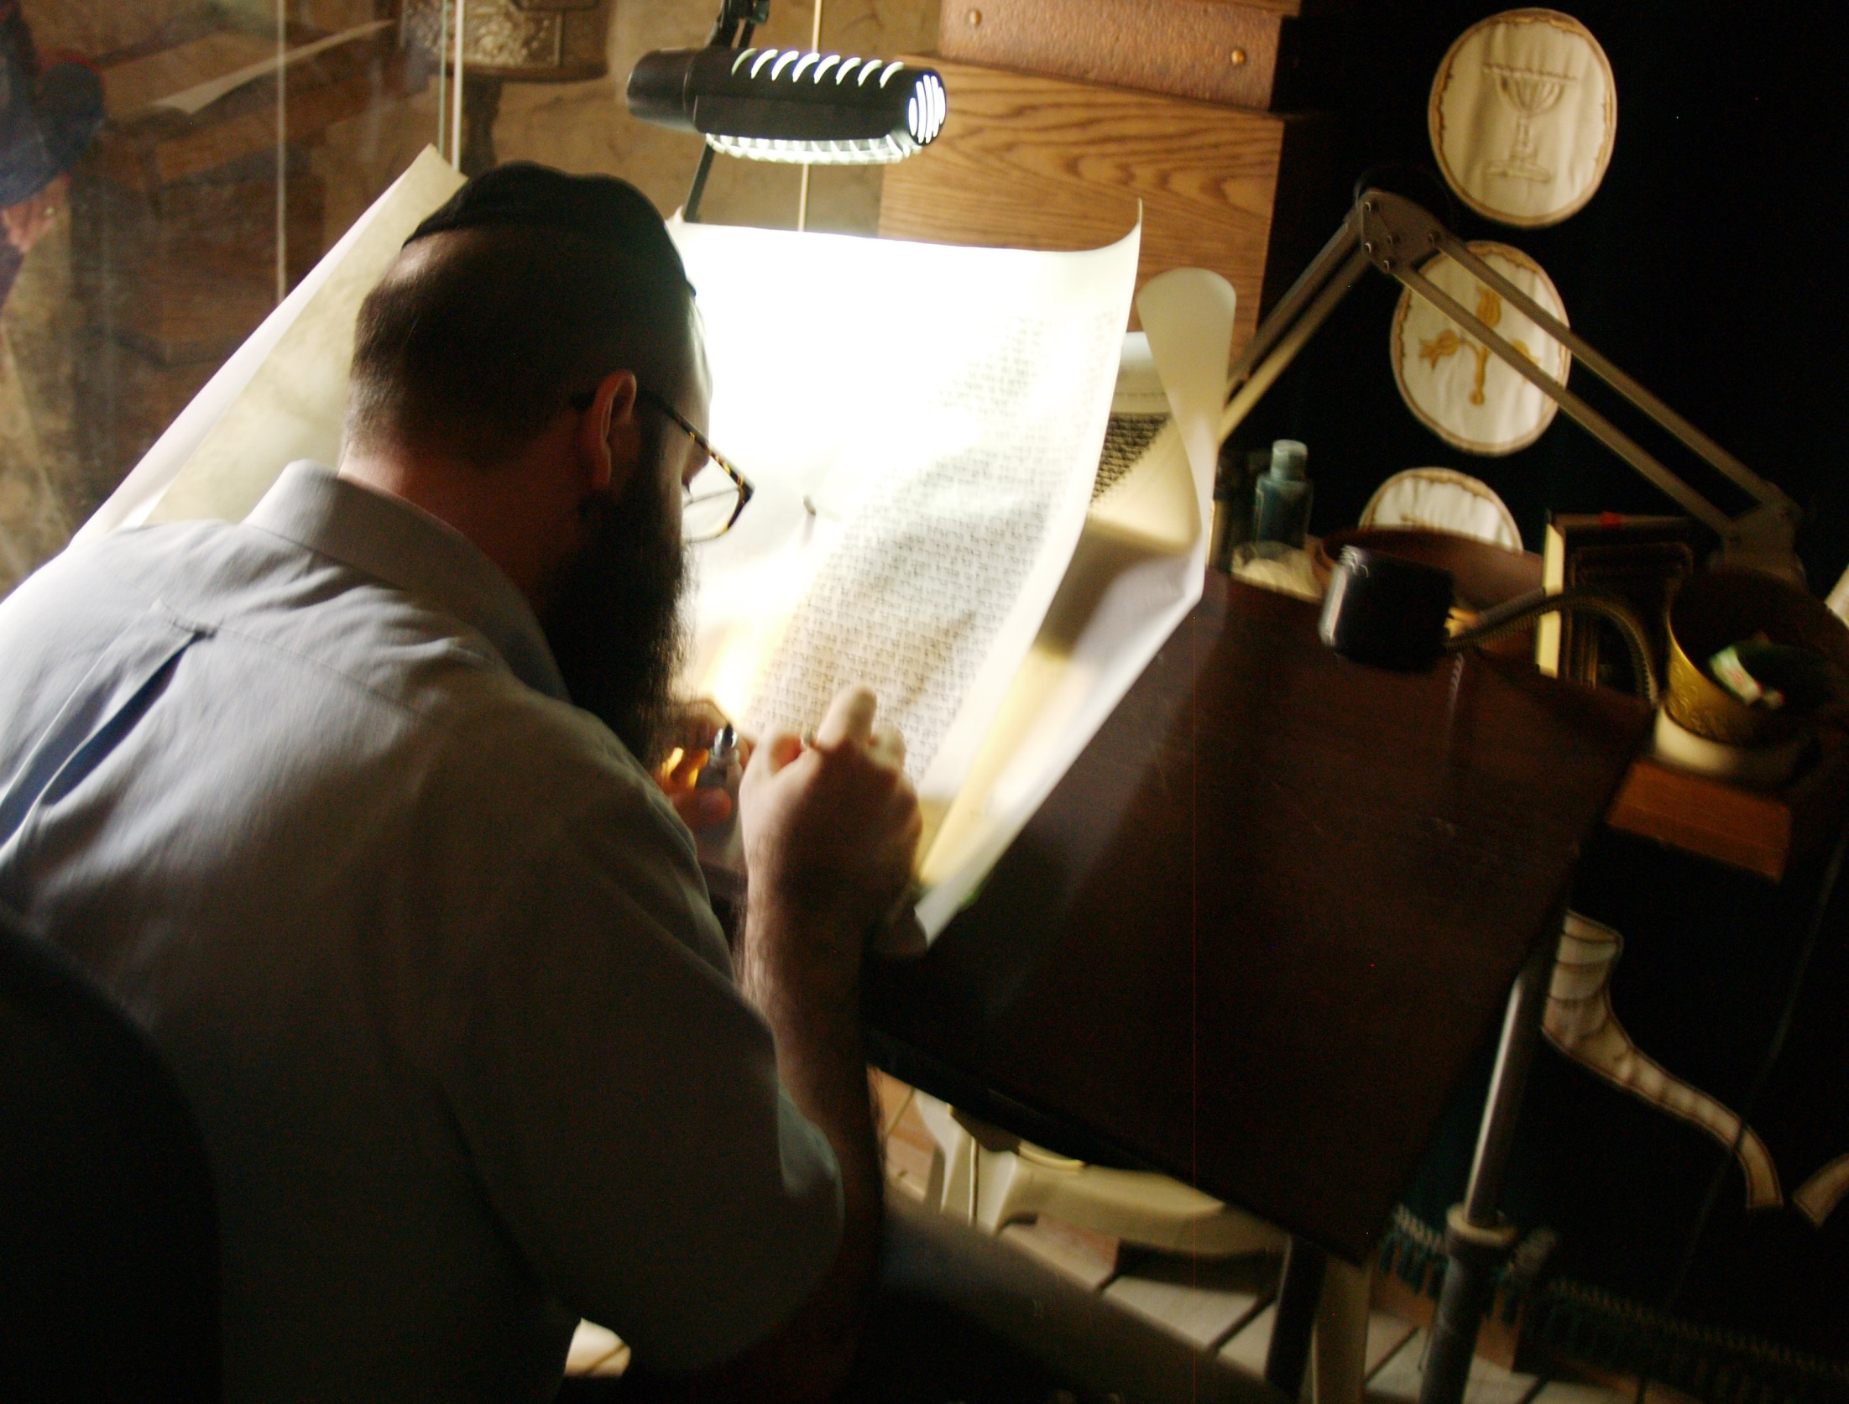
Background of
the hebrew text

Slide 15
Hebrew text
The basic Hebrew text is called the Masoretic Text (MT), which is named after a group of scribes in the ninth century that preserved the text and added vowels and punctuation marks. The original Hebrew just had consonants, but a few consonants functioned as vowels. No one would know how to pronounce the Hebrew words unless vowel marks were added. This is a great help in understanding the text. (Hebrew Bible) There were three different tasks of copying the OT. The Sopherim wrote the consonantal text. The Nakdanim added the vowel points and accents. The Masoretes added the marginal notes. An example is the Kethib (what is written) and Qere (what should be read). There are over 1,300 of these. The vowels of the Qere were written in the text of the Kethib. There are three different systems of vowel pointing, the Babylonian, Palestinian and Tiberian which the Masoretes created. The marginal notes called Masora were mainly written in Aramaic and were like a concordance.

Slide 16
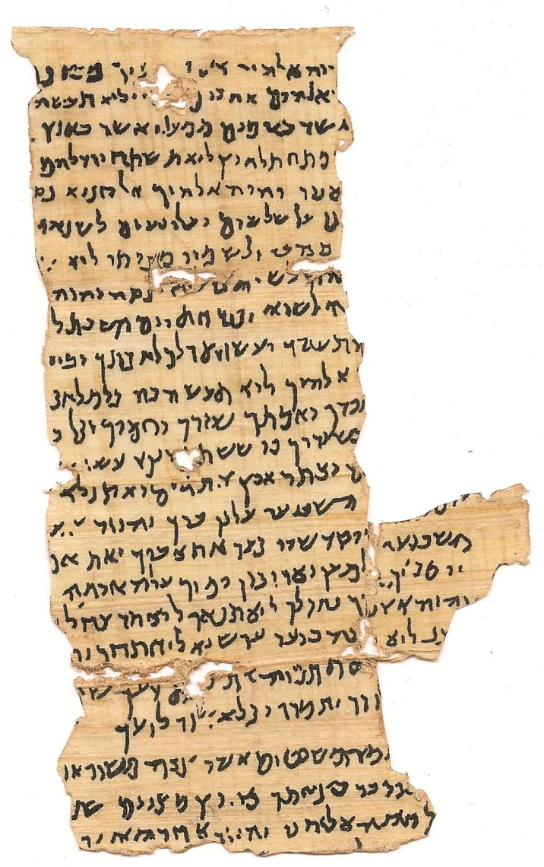
Nash Papyrus
Before the discovery of the Dead Sea Scrolls the Nash Papyrus was the oldest known witness to the OT which dated to the first or second century AD. It contained the Decalogue. It was found in Egypt in 1902. The Tetragrammaton YHWH (God's name) is visible twice on the last line.

Slide 17
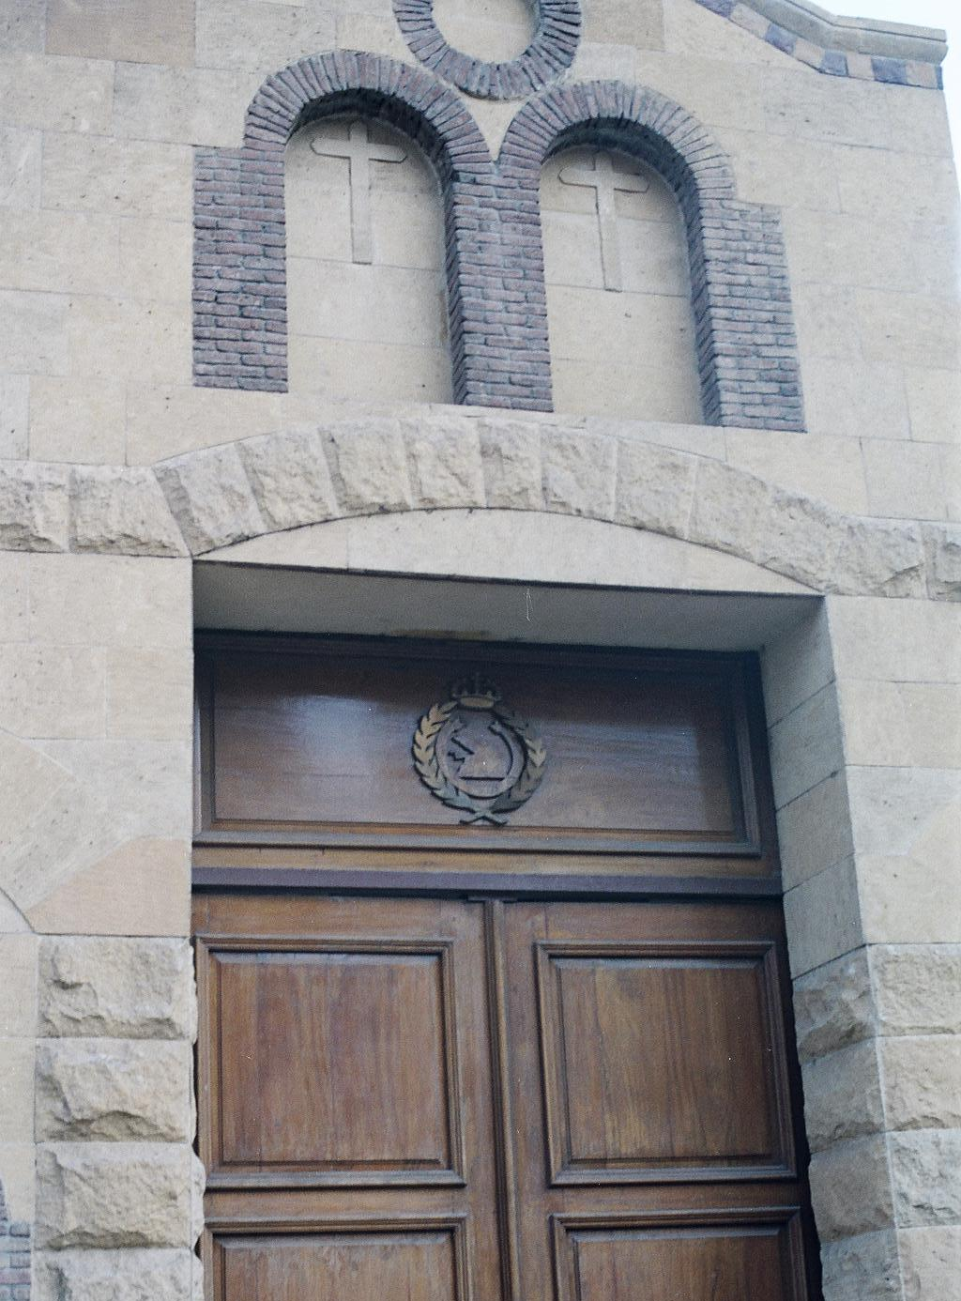
Cairo Geniza
The second oldest before the Dead Sea Scrolls were the Cairo Geniza fragments (about 280,000) which date to the fifth century AD (See Princeton Geniza Project). Most of these are in the Cambridge University Library and the Bodleian Library at Oxford. The Cairo Geniza (meaning “storeroom”) of the Ben Ezra Synagogue in Fustat, is presently Old Cairo, Egypt.
Coptic Cairo, Egypt

Slide 18
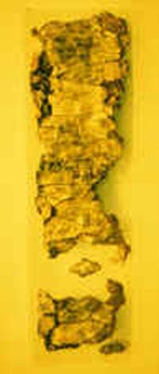
Oldest text of the
Hebrew bible
Ketef Hinnom
Silver Scrolls
OLDEST BIBLICAL TEXTS DISCOVERED about 625 B.C.
“The LORD bless you and keep you;
The LORD make His Face shine on you,
And be gracious to you;
The LORD lift up His countenance on you,
And give you peace.”
-Numbers 6:24-26

Slide 19
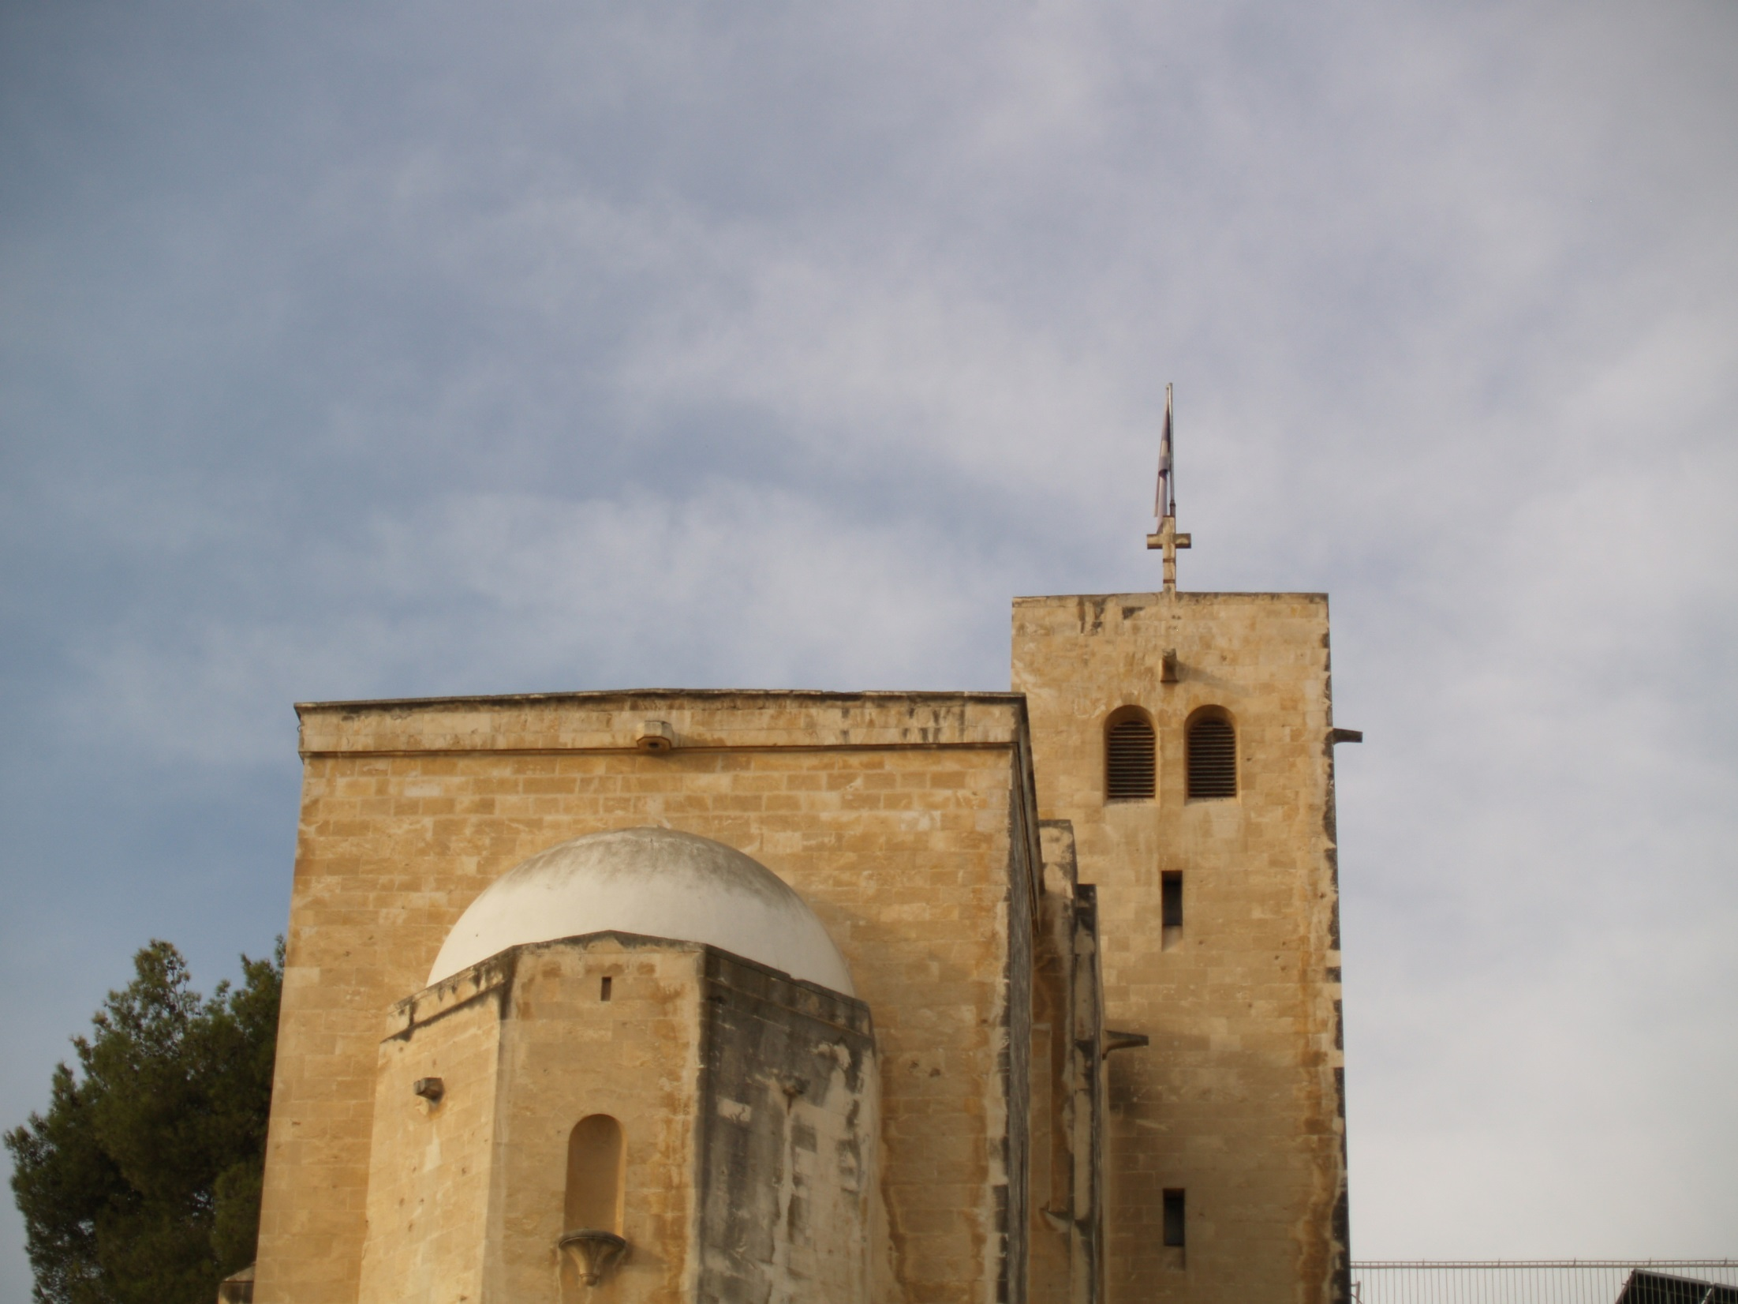
In 1979 two tiny silver scrolls, inscribed with portions of the Priestly Blessing (Numbers 6:24-26) and once used as amulets, were found in burial chamber 25 by archaeologist Gabriel Barkay in the Ketef Hinnom (meaning “shoulder of Hinnom”). The chance discovery by a 13-year-old "assistant" revealed that a partial collapse of the ceiling long ago had preserved the contents of Chamber 25. The delicate process of unrolling the scrolls while developing a method that would prevent them from disintegrating took three years. They contain the oldest surviving texts from the Hebrew Bible, dating from around 625 BC.
Background shows near where the silver scrolls were found.

Slide 20
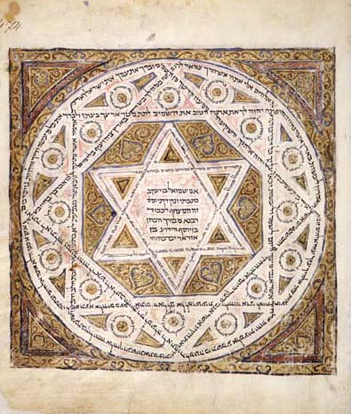
Codex Leningradensis
The oldest surviving manuscript of the complete Bible is the Codex Leningradensis which dates to 1008 AD. A Facsimile edition of this great codex is now available (Leningrad Codex 1998, Eerdmans). The BHS (Biblia Hebraica Stuttgartensia) follows this codex.

Slide 21
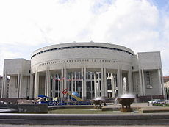
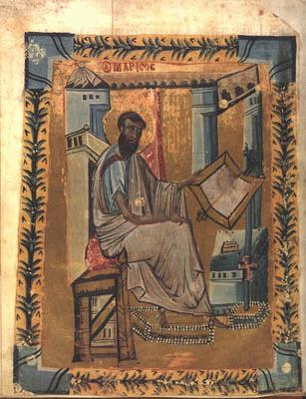
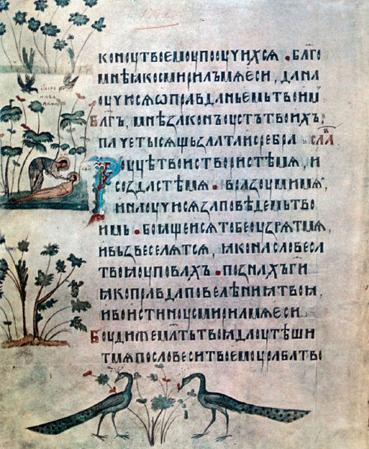
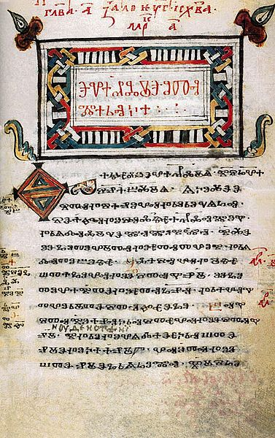
The most comprehensive collection of old Hebrew manuscripts is in the Russian National Library in St. Petersburg formerly called Leningrad. It is the oldest public library in Russia.
Trebizond Gospel
Spiridon Psalter
Codex Zographensis

Slide 22
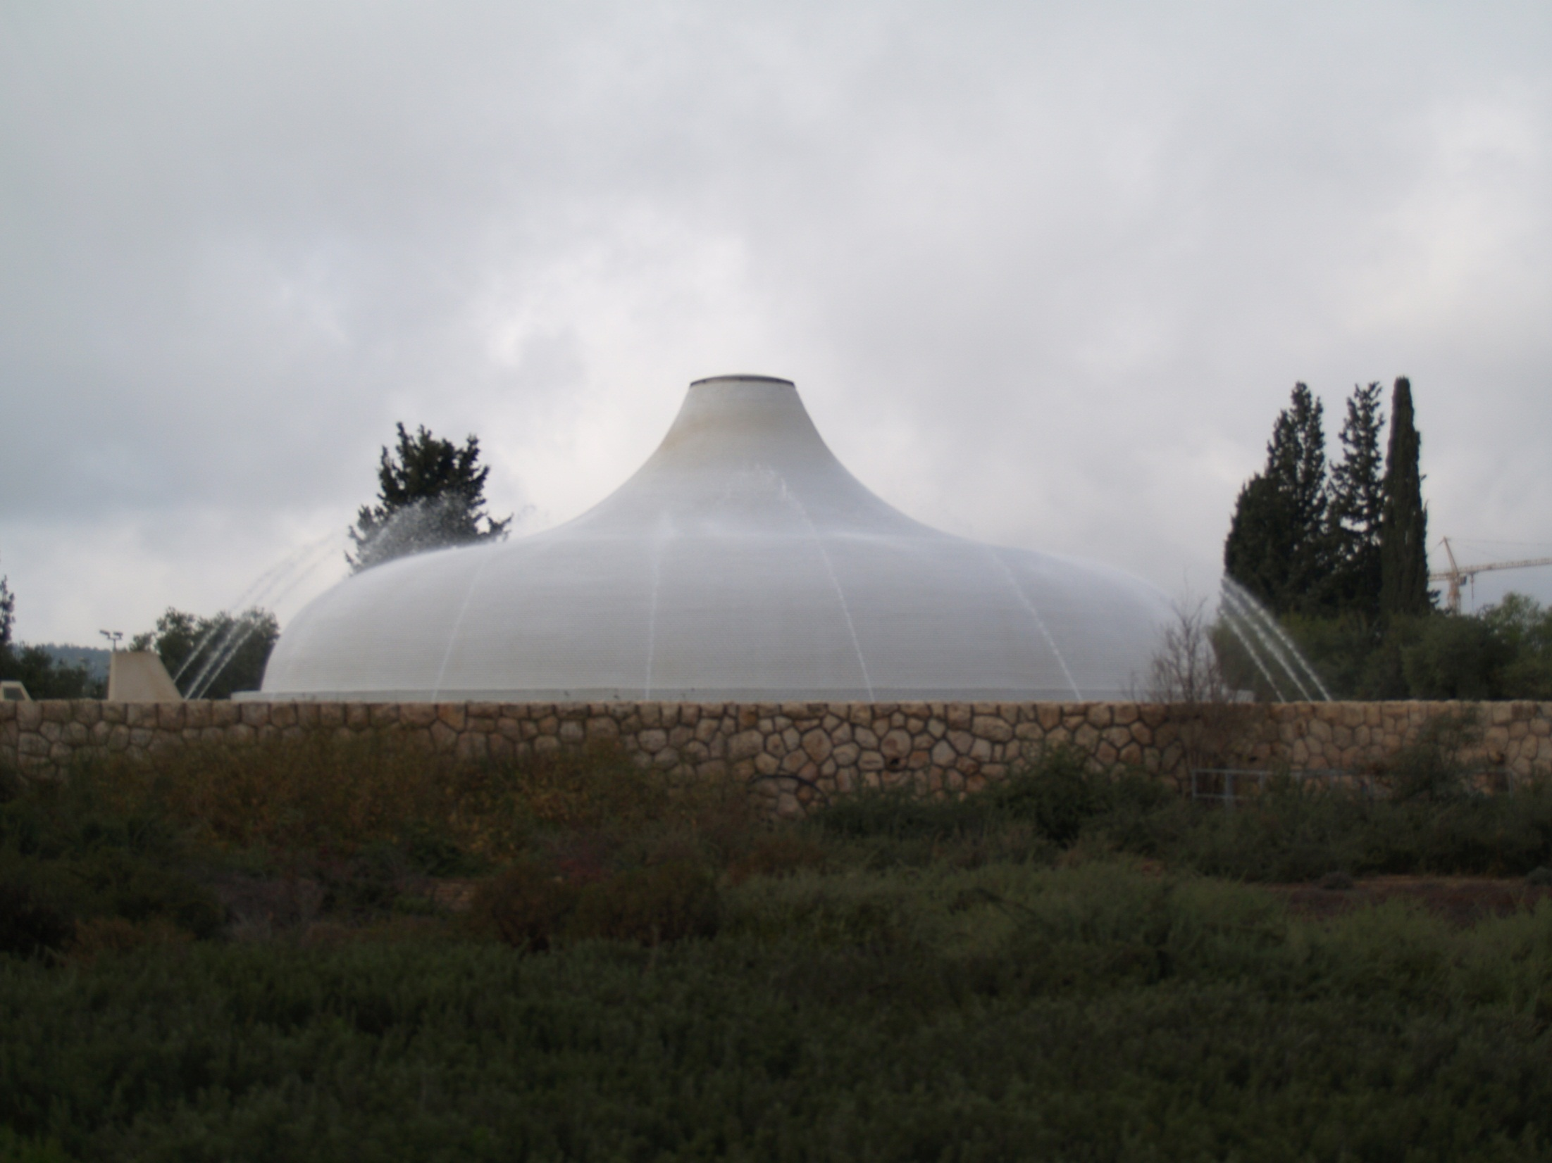
Another important text is the Aleppo Codex which is now in the Israel Museum, Jerusalem. The HUB (Hebrew University Bible) follows the Aleppo Codex. For a more detailed study see The Text of the Old Testament by Ernst Wurthwein and Textual Criticism: Recovering the Text of the Hebrew Bible by P. Kyle McCarter, Jr.
Aleppo codex

Slide 23
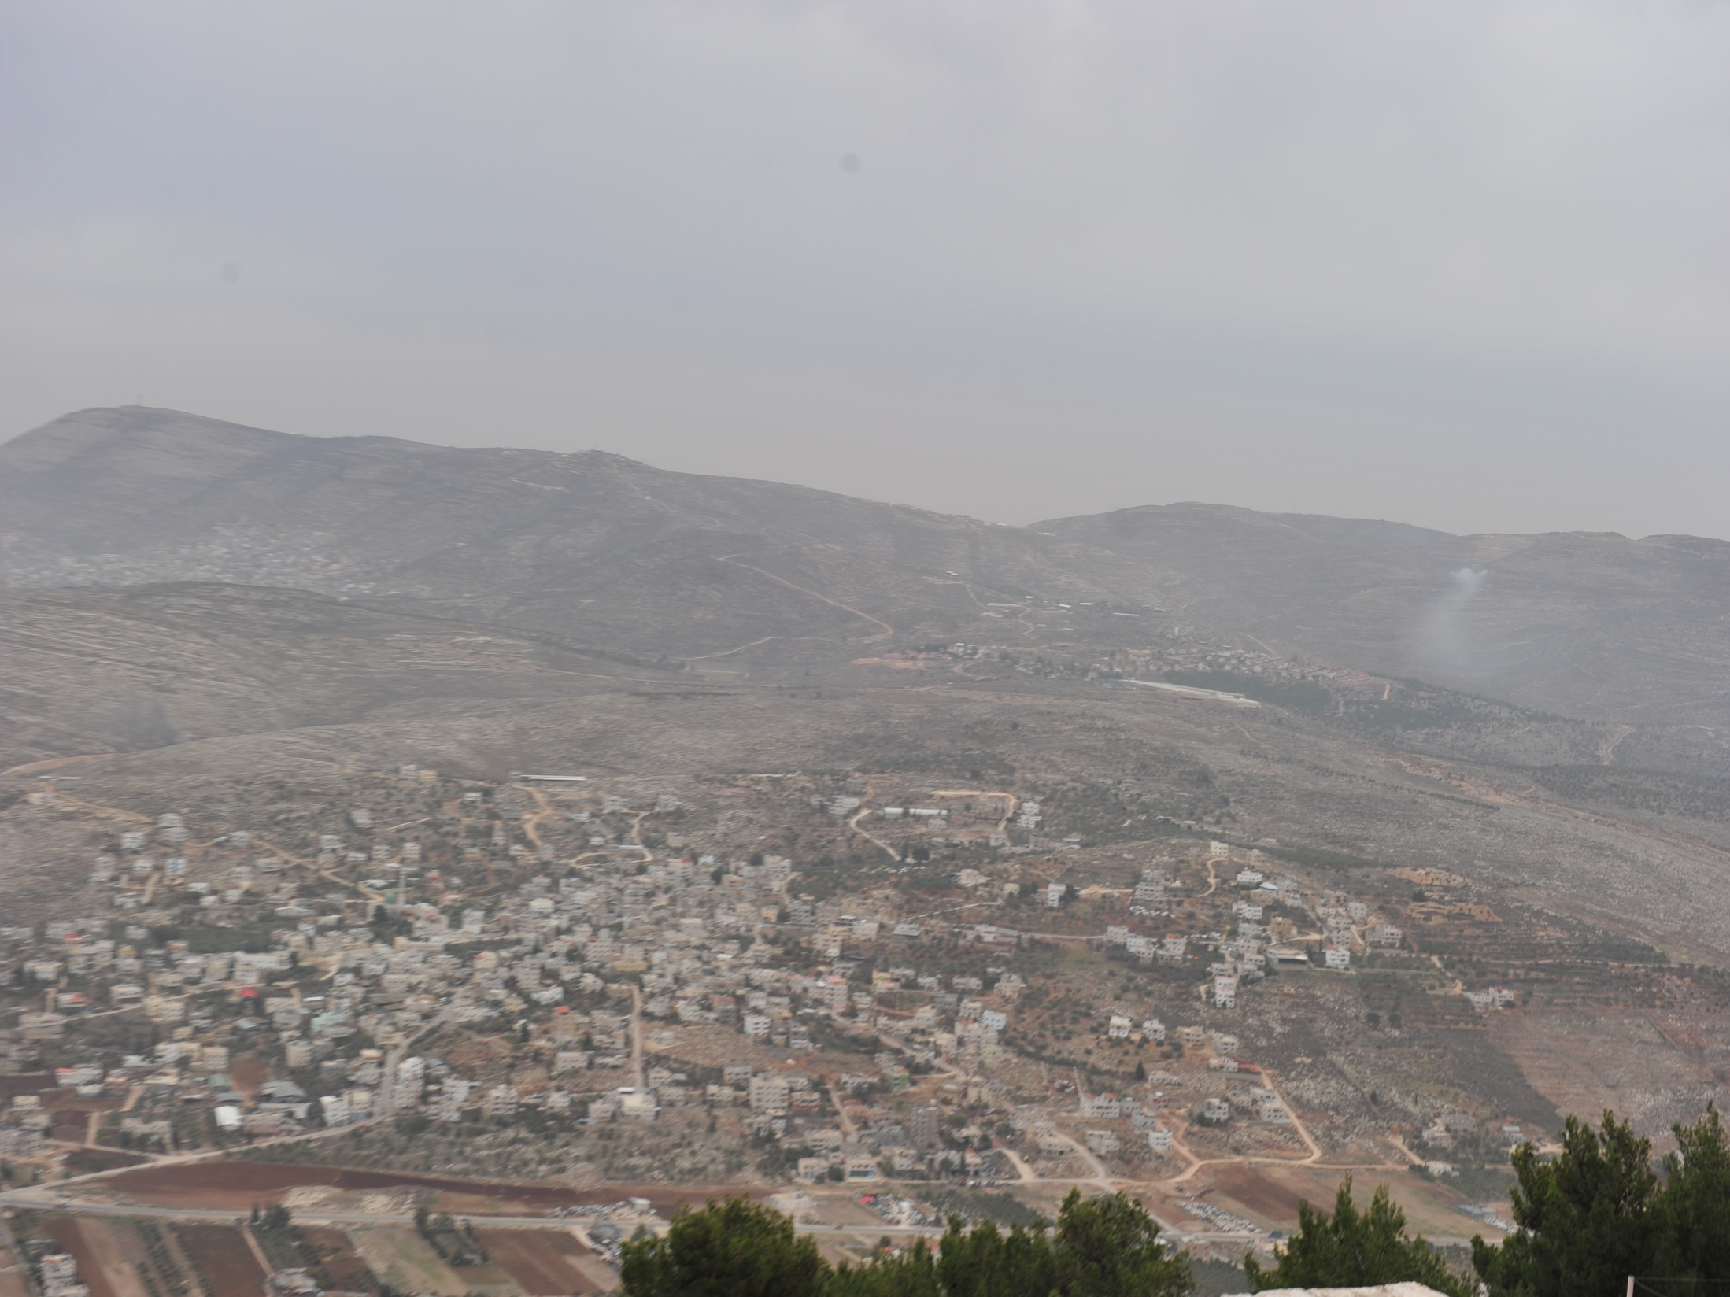
Samaritan pentateuch
The Samaritan Pentateuch (SP), is an important witness to the Hebrew text. It is preserved in ancient Hebrew called "paleo-Hebrew," whereas the Masoretic Text (MT) is in Aramaic block script. Some places differ from the MT especially where to worship, but when the SP agrees with the Septuagint it can be an important alternate reading. There are 1900 such instances (Wurthwein 1979, 43). The only striking difference in Genesis is the chronology in chapters 5 and 11.
The Samaritan Targum translates the Samaritan Pentateuch into Aramaic which can show us how they understood the text. There was no official recension of this targum so surviving manuscripts have their own text.
View from Mt Gerizim

Slide 24
targums
The targums are the Aramaic translation of the Hebrew texts. As a result of the Babylonian captivity the Jews learned Aramaic and forgot Hebrew. From the conquest of Cyrus the Great to the conquest of Alexander the Great the lingua franca of the day was Aramaic. Even in the New Testament Jesus most likely spoke Aramaic, the common language of Palestine at that time. The book of Matthew was probably originally written in Aramaic. I think this accounts for the differences in the other synoptic gospels. It is very interesting to see how the Targums translated and explained the OT.
The block script of Aramaic was adopted for writing the Hebrew text. This might have been to distinguish it from the Samaritan Pentateuch. In some of the Dead Sea Scrolls the name of God was written in Paleo-Hebrew while the rest of the text was in Aramaic block script.
The Targums can be divided geographically into two parts; Palestinian targums, and the Babylonian targums. There are three major Palestinian targums; Targum Neofiti I, Fragment Targum (Jerusalem II), and Targum Pseudo-Jonathan (Jerusalem I). There are two major Babylonian targums; Targum Onkelos for the Pentateuch, and Targum Jonathan for the Prophets. These two are authoritative for Judaism. These targums have been purged of midrashic additions.

Slide 25
talmud
According to Jewish tradition, Ezra founded the "Great Assembly" of teachers who would preserve the oral traditions. Towards the middle of the third century BC the Great Assembly ceased and another organization the "Sanhedrin" took charge of the affairs of the community. Hillel started the school of Tannaim (meaning Teachers) with a lenient view of the law. His contemporary Shammai also started a school, but was stricter in his views of the law. Judah the son of the great Simeon Gamaliel (Acts 5:34, and teacher of Paul, Acts 22:3), complied the Mishnah about 200 AD which is like the official textbook of the torah. Mishnah is from the root meaning "to repeat" the oral teaching. The Mishnah is arranged in six sections called Sedarim (Orders), each Order has a number of Massichtoth (Tractates). The Tosifta (Supplement) is another work that has additional teaching that was not as authoritative as the Mishnah. Commentary about the Mishnah accumulated which was called Gemara (completion) because it completes the Mishnah. The Mishnah together with the Gemara is called the Talmud. Two Talmuds were complied; the Palestinian Talmud written in Western Aramaic (similar in Biblical Aramaic), and the Babylonian Talmud written in Eastern Aramaic. Miscellaneous material of the Talmud is divided into subject matter into two categories known as Halachah and Haggadah. The Halachah is the section of the Mishnah and Gemara that deals with the law and how to keep it. The Haggadah deals with all non-legal sections, the moral lessons and opinions of the teachers. The Talmud was completed about 600 AD.

Slide 26
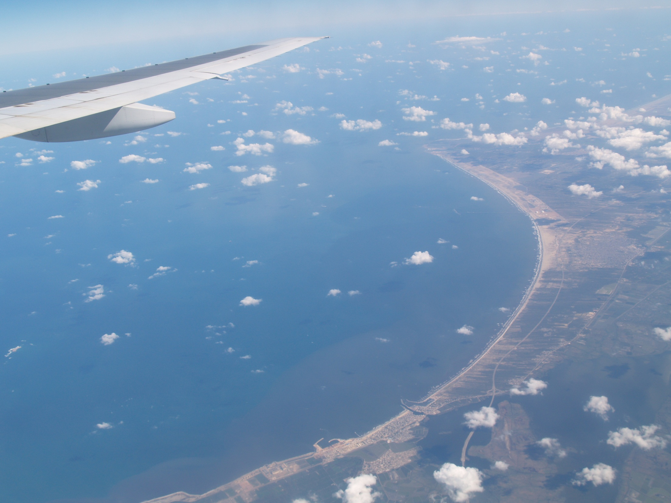
Septuagint (LXX)
The oldest and most important translation of the Hebrew Old Testament (OT) is the Septuagint (LXX). It translated the Hebrew into Greek in the third century BC in Alexandria, Egypt. The Letter to Aristide tells the story how the Egyptian king Ptolemy II (285-247 BC) ordered his librarian, Demetrius to collect all the books of the world. Demetrius thought there should be a Greek translation of the Torah so 72 Jews, six from each tribe, were sent to translate the Torah into Greek which they did in 72 days (Charlesworth 1985, 7-34).
There are a number of differences in the LXX from the Masoretic Text (MT), most noticeable is the Book of Jeremiah where the LXX is a third shorter. The chronology in Genesis is also very different than the MT. (Finegan 1998, 195; Larsson 1983, 401-409). Larsson believes that the translators of the LXX tried to harmonize the Biblical chronology with the Egyptian chronology of Manetho by adding 100 years to the patriarchs ages to push back the time of the flood before the first Egyptian dynasty because there is no record of a great flood. Early Christian chronologists emphasized the perfect agreement of Manetho with the LXX (Larsson, 403-4). It is interesting to see how they understood Genesis by the way they translated the text.

Slide 27
4 great uncials
Only four great codices have survived to the present day: Codex Sinaiticus, Codex Vaticanus, Codex Alexandrinus, and Codex Ephraemi Rescriptus.^{[1]} Though they were discovered at different times and places, they share many similarities. They are written in a certain uncial style of calligraphy using only capital letters, written in scriptio continua (meaning without regular gaps between words).^{[1][2]} Though not entirely absent, there are very few divisions between words in these manuscripts. Words do not necessarily end on the same line on which they start. All these manuscripts were made at great expense of material and labor, written on vellum (animal skin) by professional scribes.^{[3]} They seem to have been based on the most accurate texts in their time. Wikipedia

Slide 28
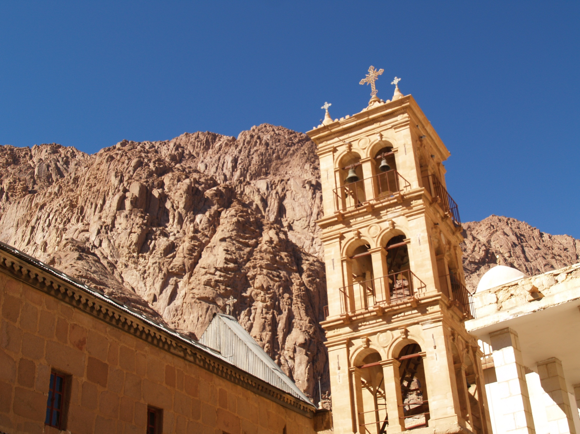
Codex sinaiticus
Discovered in 1844 by
Constantin von Tischendorf
at Monastery of Saint Catherine at the bottom of Mt. Sinai.

Slide 29
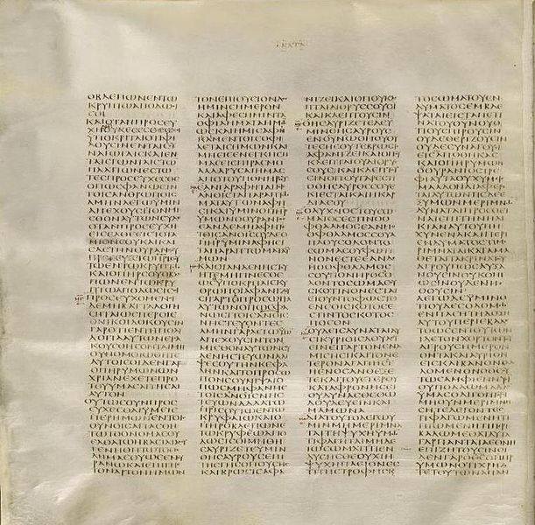
Codex Sinaiticus is an ancient, handwritten copy of the Greek Bible. It is an Alexandrian text-type manuscript written in the 4th century in uncial (capital) letters on parchment (sheep & goat skin).
The Codex Sinaiticus was discovered by Constantin von Tischendorf at the Greek Orthodox Monastery of Mount Sinai (St. Catherine’s Monastery), with further material discovered in the 20th and 21st centuries. Most of the manuscript today resides within the British Library. Since its discovery, study of the Codex Sinaiticus has proven to be extremely useful to scholars for the purposes of biblical translation.
Originally, the Codex contained the whole of both Testaments. Approximately half of the Greek Old Testament (or Septuagint) survived, along with a complete New Testament, plus the Epistle of Barnabas, and portions of The Shepherd of Hermas. Wikipedia.

Slide 30
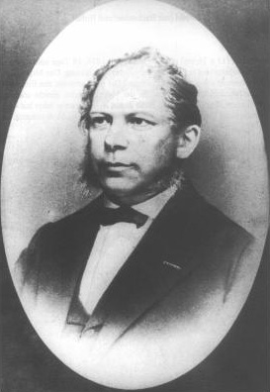
“In 1844, during his first visit to the Monastery of Saint Catherine, Leipzig archaeologist Constantin von Tischendorf claimed that he saw some leaves of parchment in a waste-basket. He said they were "rubbish which was to be destroyed by burning it in the ovens of the monastery",^{[74]} although this is firmly denied by the Monastery. After examination he realized that they were part of the Septuagint, written in an early Greek uncial script. He retrieved from the basket 129 leaves in Greek which he identified as coming from a manuscript of the Septuagint. He asked if he might keep them, but at this point the attitude of the monks changed. They realized how valuable these old leaves were, and Tischendorf was permitted to take only one-third of the whole, i.e. 43 leaves. These leaves contained portions of 1 Chronicles, Jeremiah, Nehemiah, and Esther. After his return they were deposited in the Leipzig University Library, where they still remain.” Wikipedia.

Slide 31
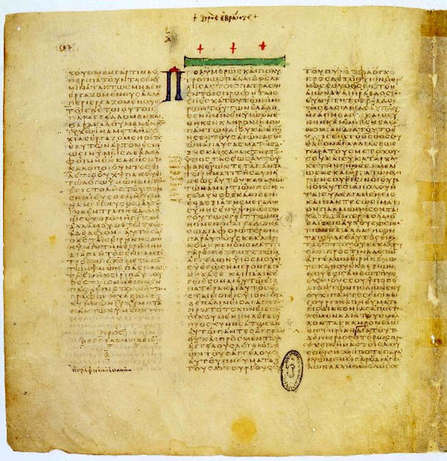
Codex vaticanus
It is written on 759 leaves of vellum in uncial letters, and has been dated palaeographically to the 4th century AD.

Slide 32
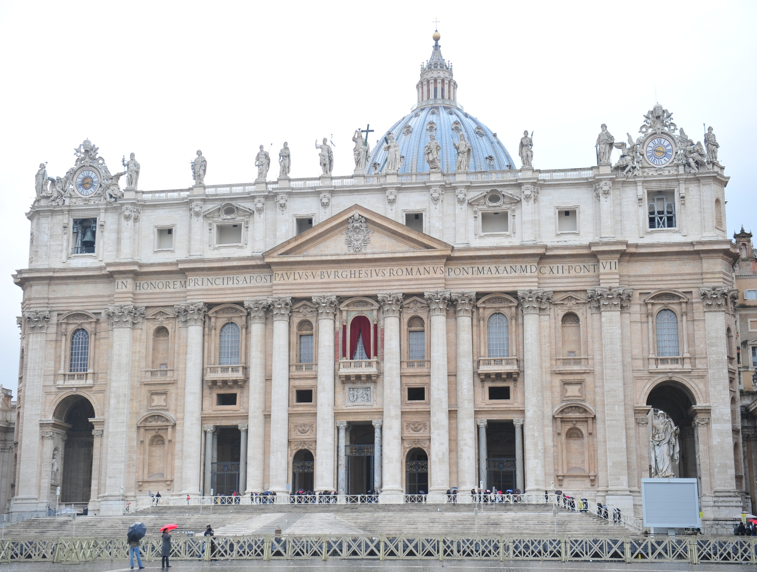
Codex
vaTICANUS
The Codex is named for the residence in the Vatican Library where it has been stored since at least the 15th century.

Slide 33
Codex vaticanus
The manuscript became known to Western scholars as a result of correspondence between Erasmus and the prefects of the Vatican Library. Portions of the codex have been collated by several scholars, but numerous errors were made in the process. The Codex's relationship to the Latin Vulgate was unclear, and scholars initially were unaware of the Codex's value,^{[4]} which changed in the 19th century, when transcriptions of the full codex were completed.^{[1]} At that point scholars realised the text differed from the Vulgate and the Textus Receptus.^{[5]}
Current scholarship considers the Codex Vaticanus to be one of the best Greek texts of the New Testament,^{[3]} with that of the Codex Sinaiticus as its only competitor. Until the discovery by Tischendorf of the Sinaiticus text, the Codex was unrivaled.^{[6]} It was extensively used by Westcott and Hort in their edition of The New Testament in the Original Greek in 1881.^{[3]} The most widely sold editions of the Greek New Testament are largely based on the text of the Codex Vaticanus.^{[7]} Wikipedia.

Slide 34
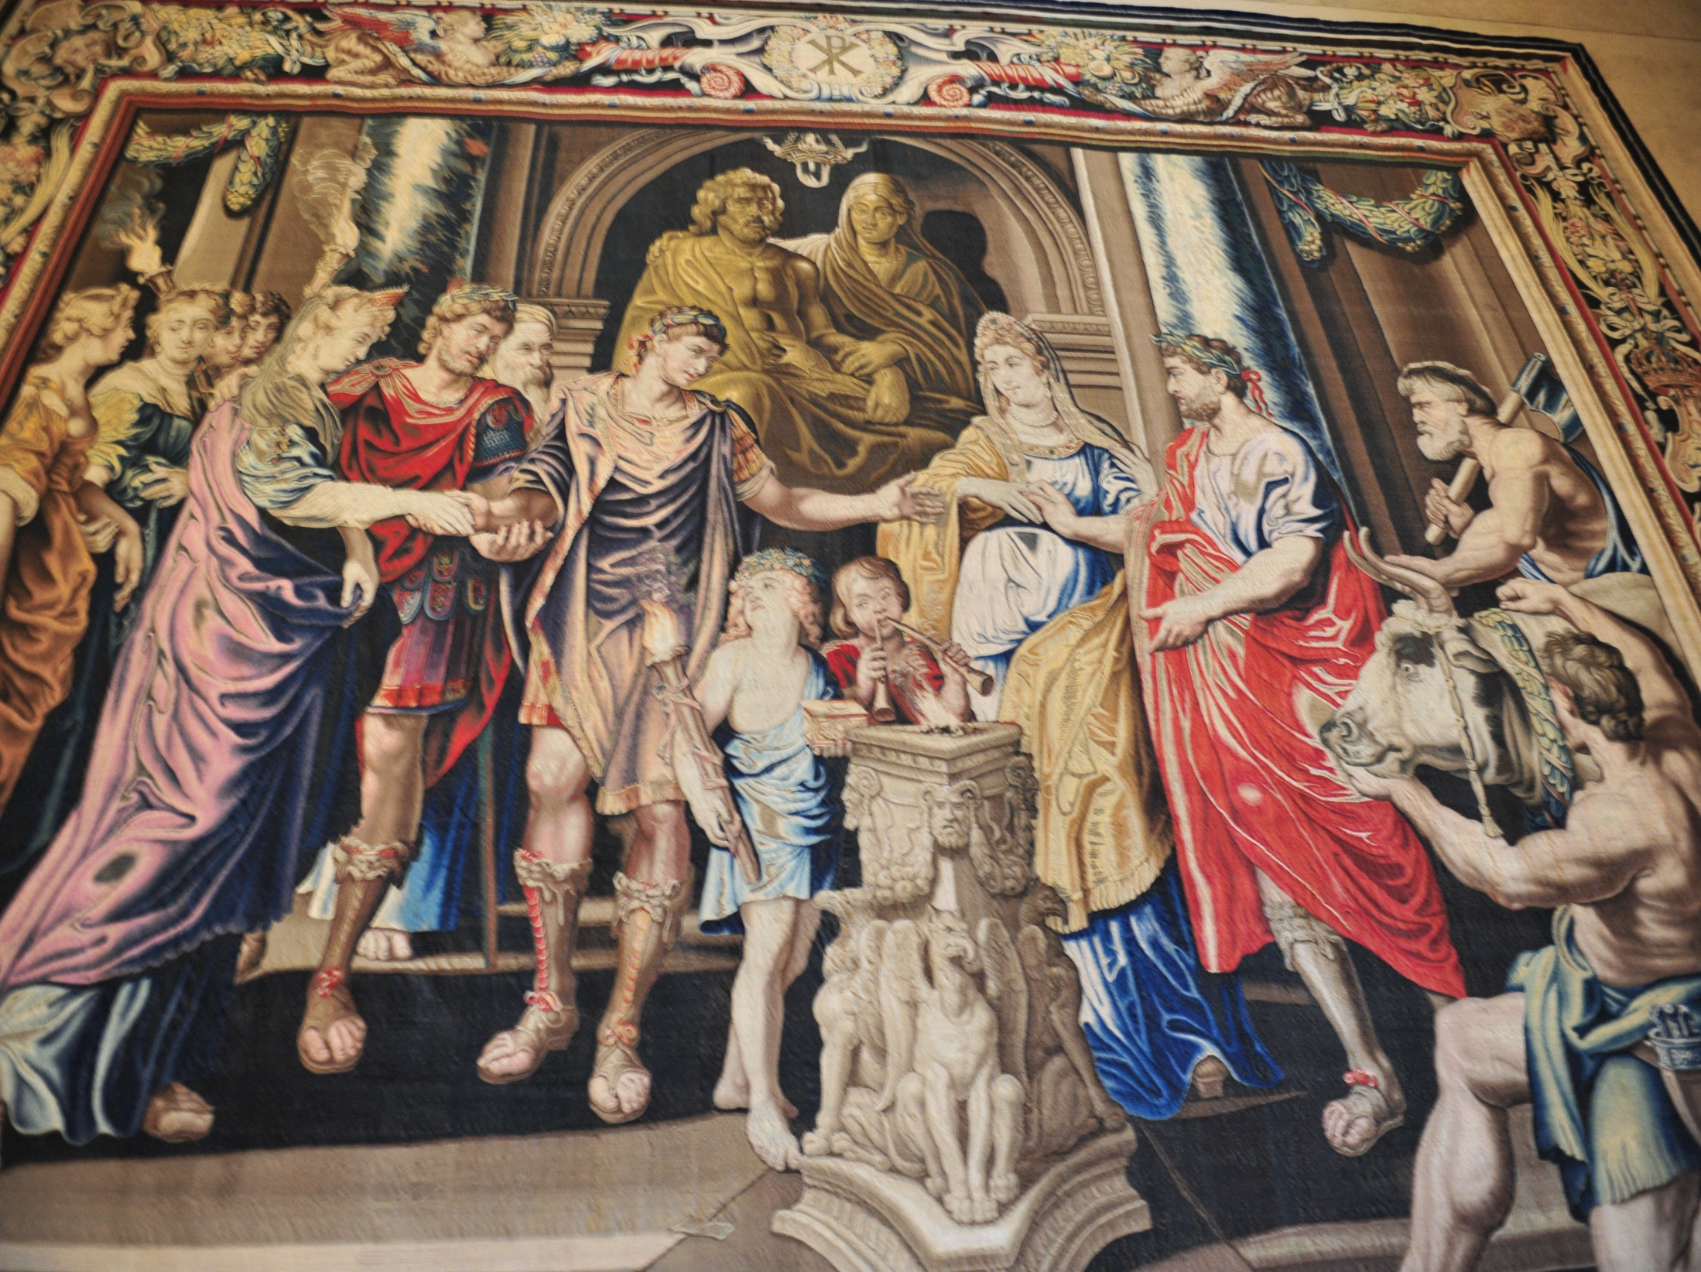
Constantine the great
It has been speculated that Codex Sinaiticus and Codex Vaticanus were part of a project ordered by Emperor Constantine the Great to produce 50 copies of the Bible.

Slide 35
Codex alexandrinus
Codex Alexandrinus was the first of the greater manuscripts to be made accessible to scholars. It is a 5th century manuscript of the Greek Bible,^{[n 1]} containing the majority of the Septuagint and the New Testament.^{[1]} It received the name Alexandrinus from its having been brought by the Eastern Orthodox Patriarch Cyril Lucaris from Alexandria to Constantinople (17th Century).^{[2] Wikipedia}
Egypt

Slide 36
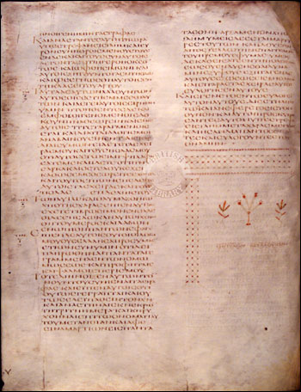
Codex alexandrinus
The codex Alexandrinus contains almost a complete copy of the LXX, including the deuterocanonical books 3 and 4 Maccabees, Psalm 151 and the 14 Odes. The "Epistle to Marcellinus" attributed to Saint Athanasius and the Eusebian summary of the Psalms are inserted before the Book of Psalms. It also contains all of the books of the New Testament, in addition to 1 Clement (lacking 57:7-63) and the homily known as 2 Clement (up to 12:5a). Wikipedia.

Slide 37
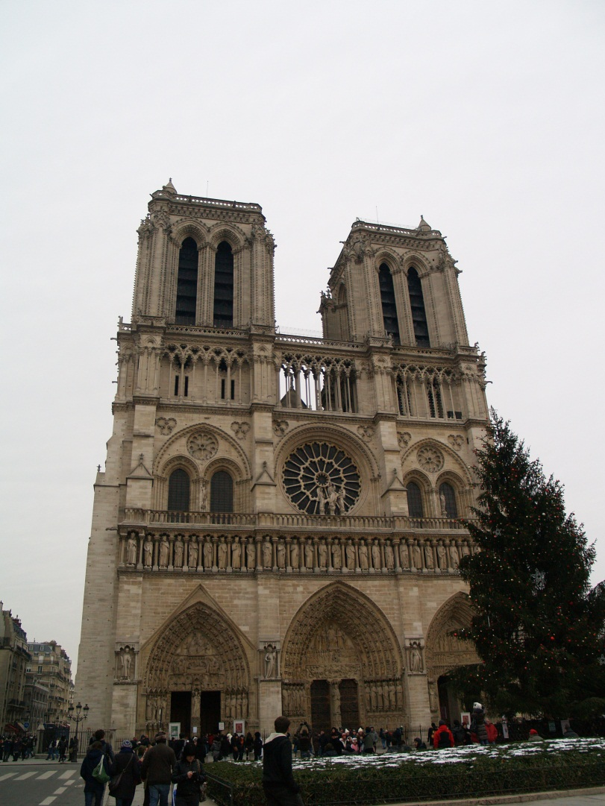
Codex Ephraemi rescriptus
Codex Ephraemi Rescriptus housed in Paris, National Library of France, is an early 5th century Greek manuscript of the Bible, the last in the group of the four great uncial manuscripts of the Greek Bible. The manuscript is lacunose. Originally the whole Bible seems to have been contained in it.
It receives its name, as a codex in which the treatises of Ephraem the Syrian, in Greek translations, were written over ("rescriptus") a former text that had been washed off its vellum pages, thus forming a palimpsest.^{[1]} The later text was produced in the 12th century. The effacement of the original text was incomplete, for beneath the text of Ephraem are the remains of what was once a complete Bible, containing both the Old Testament and the New. Wikipedia
Notre Dame in Paris, France

Slide 38
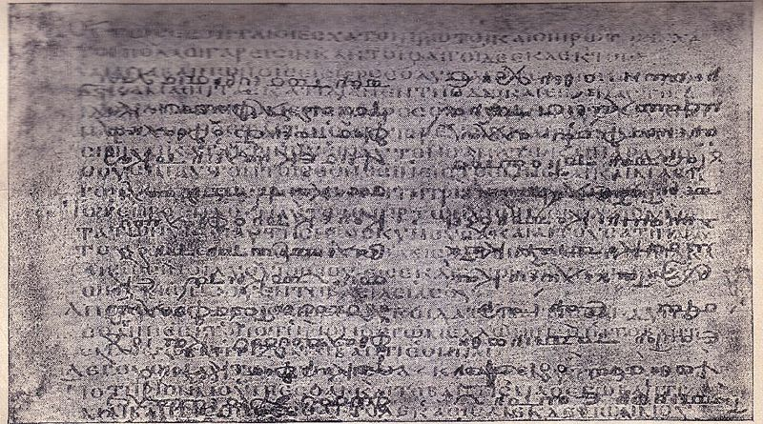
Codex Ephraemi rescriptus
There are only 209 leaves of the Codex surviving, of which 145 belong to the New Testament and 64 to the Old Testament. The text is written in a single column per page, 40-46 lines per page, on parchment leaves. The lower text of the palimpsest was deciphered by Tischendorf in 1840-1841.

Slide 39
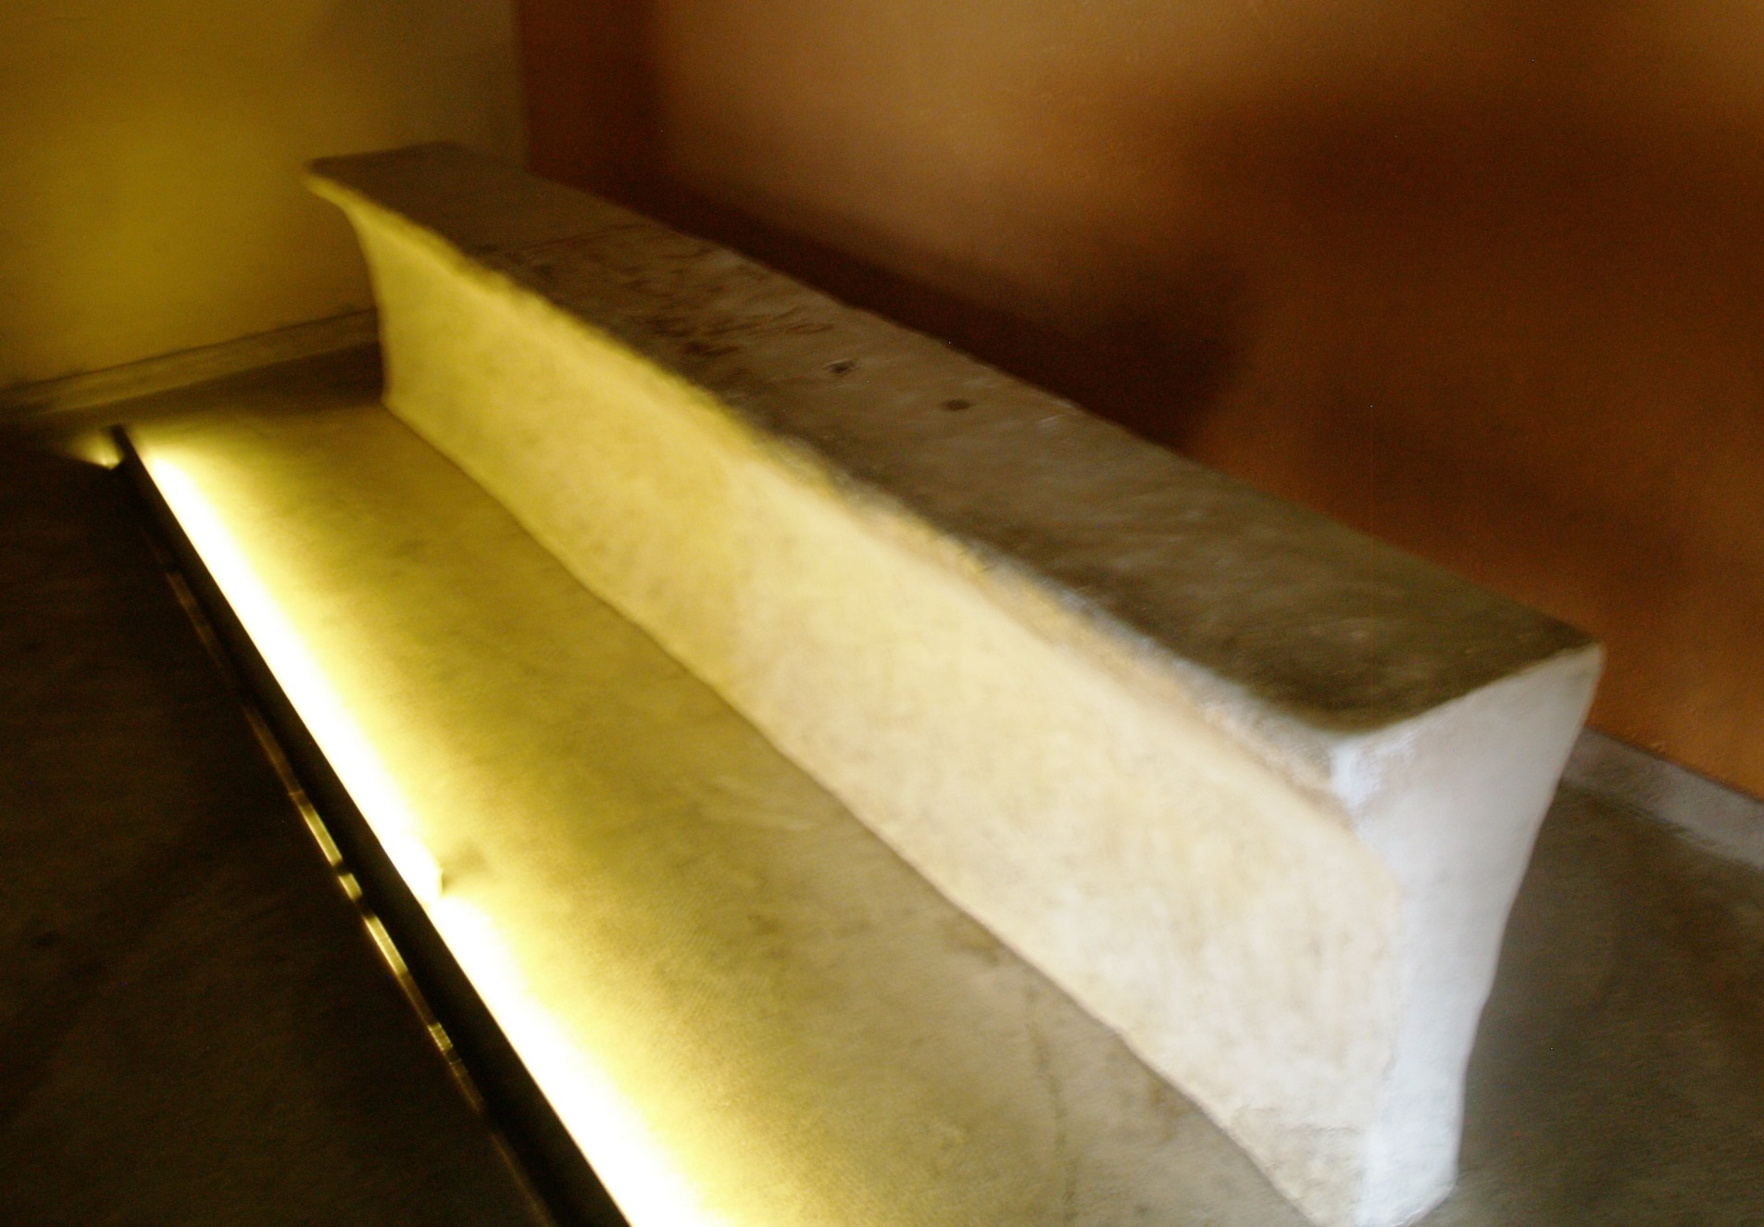
Dead sea scroll texts
Table for copying scriptures at Qumran.

Slide 40
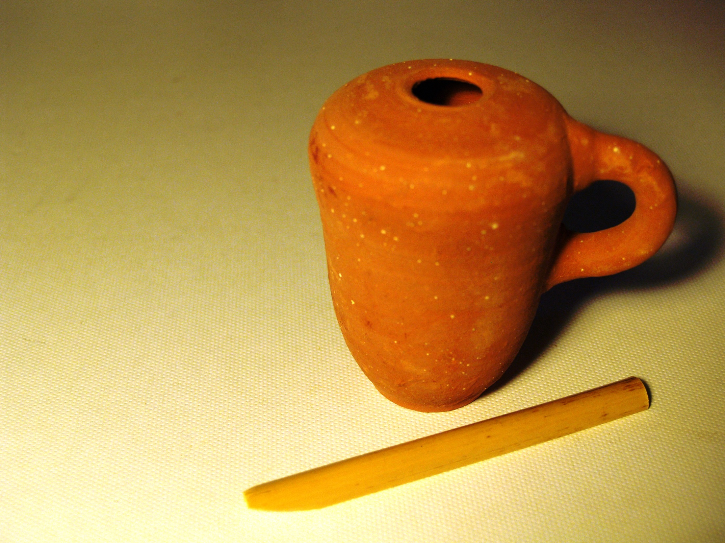
Qumran
Inkwell
The most popular books in the Dead Sea Scrolls are Isaiah, Psalms, and Deuteronomy.

Slide 41
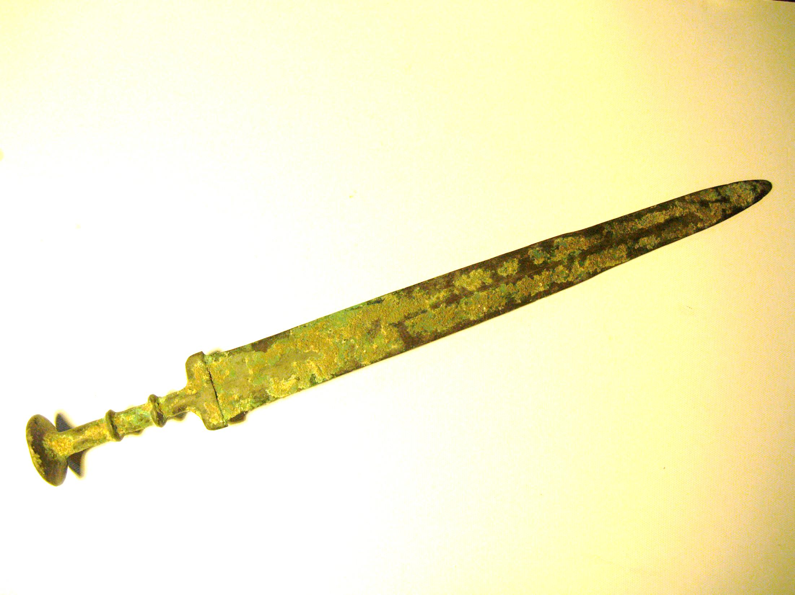
Liberal Minimalists
Before the discovery of the Dead Sea Scrolls many liberals thought that the Old Testament was not accurately copied. It is like whispering in someone’s ear and passing the message around the room. It is all jumbled up at the end. The Dead Sea Scrolls showed how accurately the Old Testament (Tanakh) had been copied, but the devil is in the details. The Dead Sea Scrolls are like a two edged sword that can cut both ways. It can show certain things may be false and certain things to be true. Much depends on how you interpret the data. In Biblical Archaeology there are the maximalists who believe the Bible is more trustworthy, and the minimalists who believe the Bible is not very trustworthy historically. Fundamentalists on the other hand see every word being reserved. Some extremes see the KJV 1611 as the only inspired word of God. In the Dead Sea Scrolls we see that a paragraph was missing, and also lines, and words went missing. Verses, chapters, and psalms have been rearranged. There are rewritten texts, and at least three major editions of the Old Testament. Yes, it has been copied very accurately, yet there have been many minor changes, and some major changes. The best answer lies somewhere between these extremes.
Fundamentalist Maximalists

Slide 42
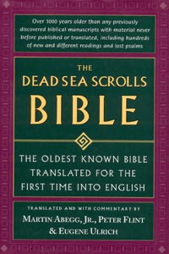
Three of the most important Biblical texts from Qumran are: (1) The Great Isaiah Scroll from Cave 1. (2) The Habakkuk Commentary from Cave 1 which uses the pesher method of interpretation, and the name Yahweh is written in paleo-Hebrew. (3) The Psalm scroll from Cave 11 contains 41 canonical psalms and 7 apocryphal psalms mixed in among them. The order of the psalms differs largely from the MT (Wurthwein 1979, 32).
This is an excellent book with translations of the Bible from the Dead Sea Scrolls. Differences are italicized. The Dead Sea Scrolls Bible translated by Abegg, Flint, and Ulrich. Published by HaperSanFranciso, 1999

Slide 43
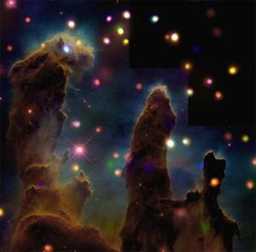
Genesis texts
Genesis 1:9
4QGen^{k} has added "and dry land appeared" indicating that the longer reading of the LXX is from an ancient Hebrew text that the MT lost by haplography. The LXX addition says, "and the waters below heaven gathered into their gathering place and dry land appeared" (See Charlesworth, 2000, p.200).
Pillars of Creation, Eagle Nebula (NASA)

Slide 44
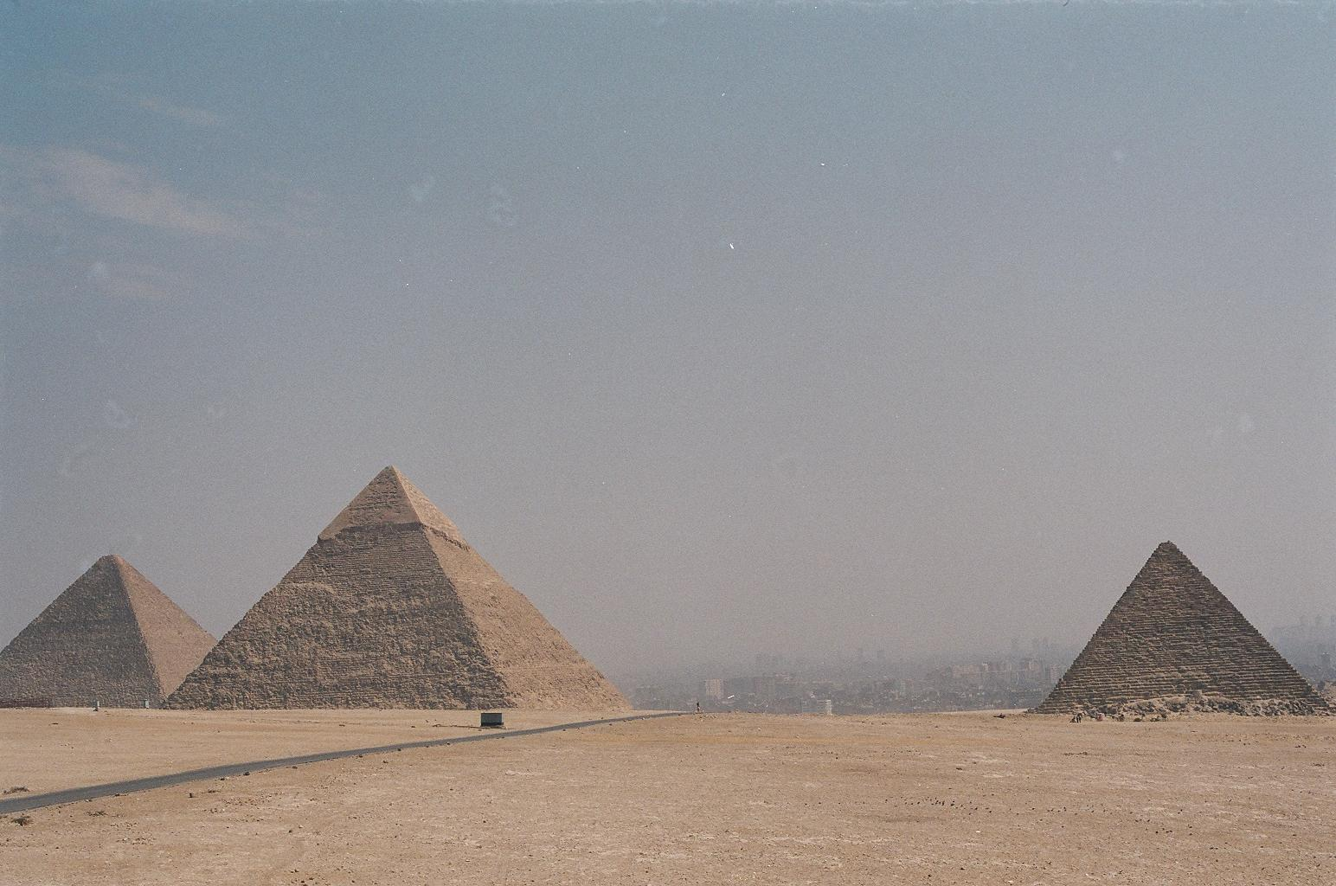
Genesis 5
The chronology in LXX Genesis chapter five is also very different than the MT. (Finegan 1998, 195; Larsson 1983, 401-409). Larsson believes that the translators of the LXX tried to harmonize the Biblical chronology with the Egyptian chronology of Manetho by adding 100 years to the patriarchs ages to push back the time of the flood before the first Egyptian dynasty because there is no record of a great flood. Early Christian chronologists emphasized the perfect agreement of Manetho with the LXX (Larsson, 403-4). It is interesting to see how they understood Genesis by the way they translated the text.

Slide 45
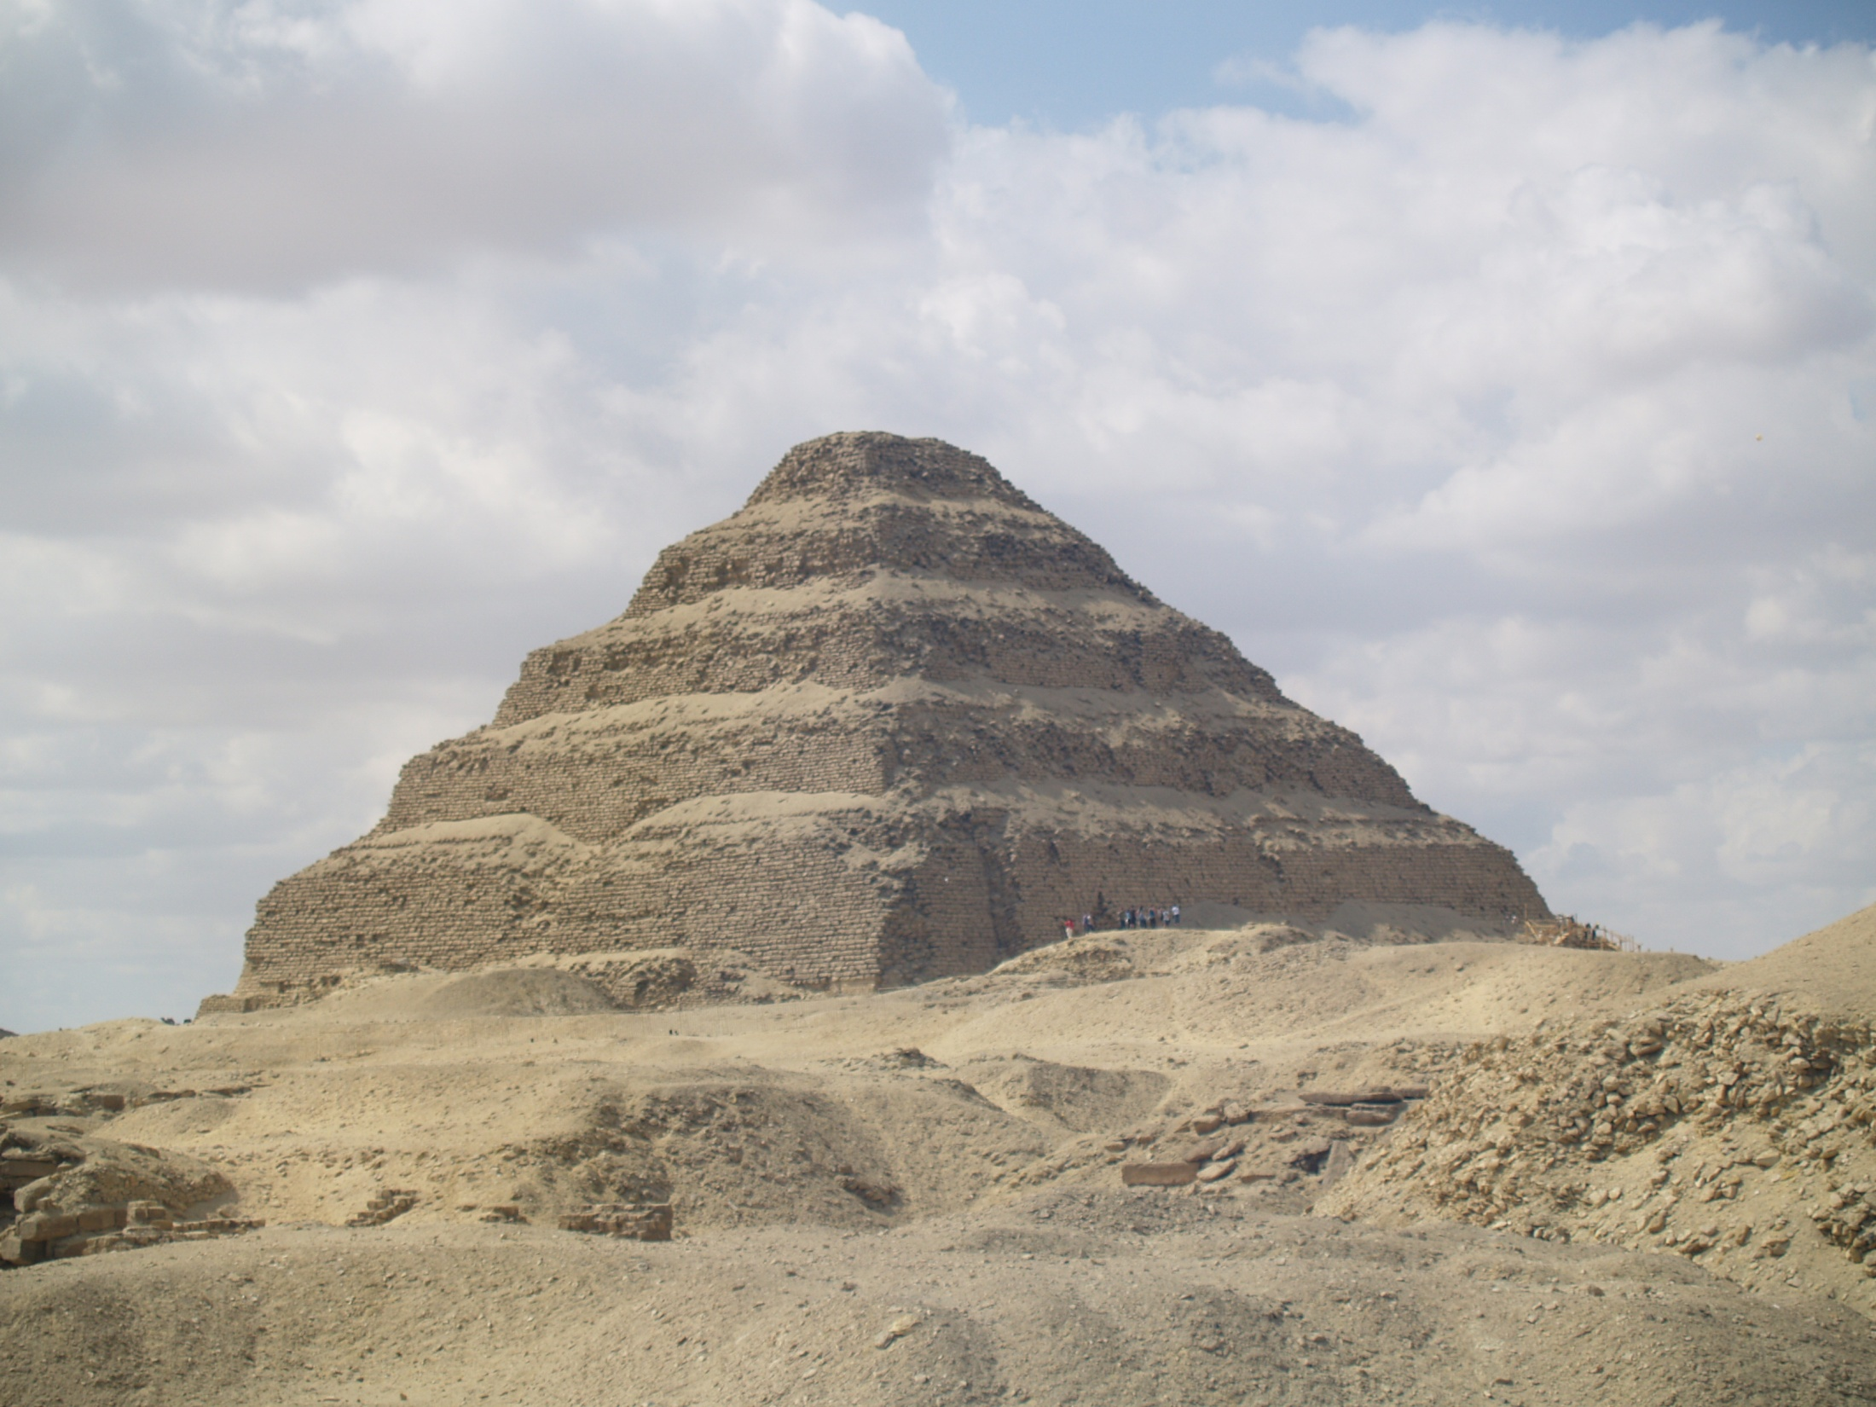
Exodus Texts
Most of the DSS Exodus texts are very similar to the MT. 4QpaleoExod(m) is a clear example of a different edition of Exodus which is similar to the Samaritan version which contain expansions. The addition of the 11th commandment to build an altar on Mt. Gerizim is not included.
Step Pyramid

Slide 46
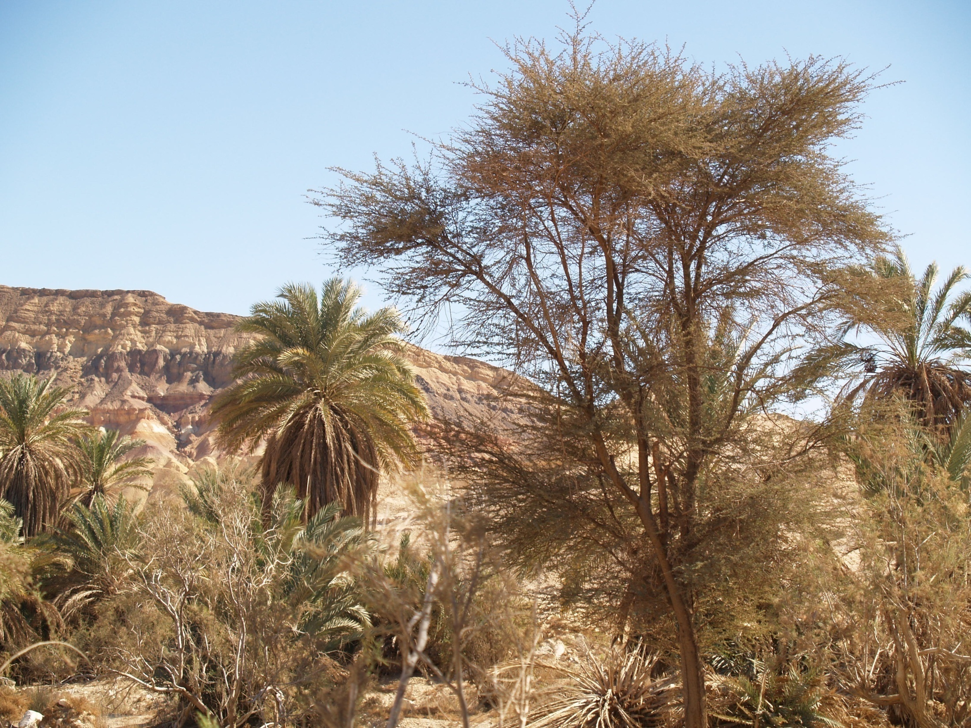
Numbers dss texts
There were at least two editions of Numbers during the Second Temple period. 4QNum(b) represents an expanded version of Numbers that the Samaritans followed.
Dophkah? Numbers 33:12

Slide 47
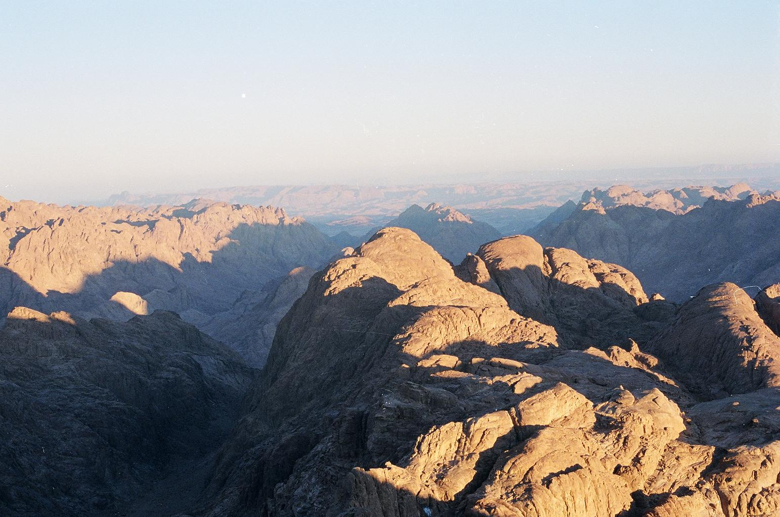
Deuteronomy dss texts
Deuteronomy 32:8
The MT and SP have “according to the number of the sons of Israel.”
4QDeut(j) and the LXX have “according to the number of the sons of God.” The MT looks like a theological revision because “sons of Israel” does not make sense in the context.
Mt Sinai

Slide 48
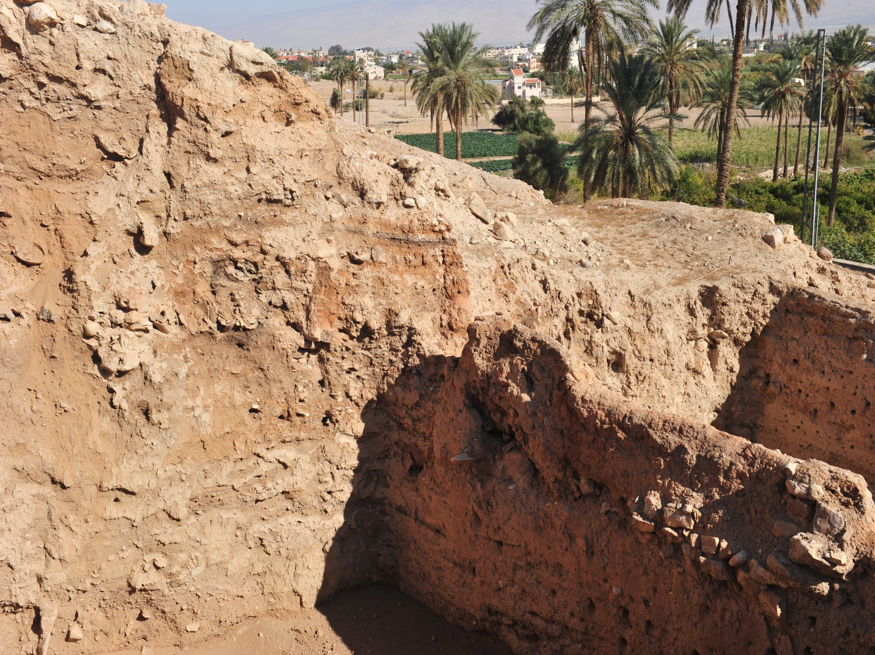
Joshua Texts
A. Rofe research suggested that the addition after Joshua 24:33 reflects an earlier and more original development were Joshua and Judges were combined together. The end of Joshua is followed by Judges 3 with the first two chapters of Judges added later. Rofe also saw the cities of refuge in Joshua 20:4-6 as later additions which are not found in the LXX. The MT later adds the quote form Deuteronomy. Joshua in the LXX is 4-5% shorter than the MT of Joshua (Joshua 6, 12, 20). These minuses should be seen as additions by the MT. The 4QJoshª also differs from the MT.
There is also a major change in the sequence of events in the LXX of Joshua. The building of the altar at Shechem in Joshua 8:30-35 (MT) is moved to chapter 9:3 in the LXX.
Walls of Jericho

Slide 49
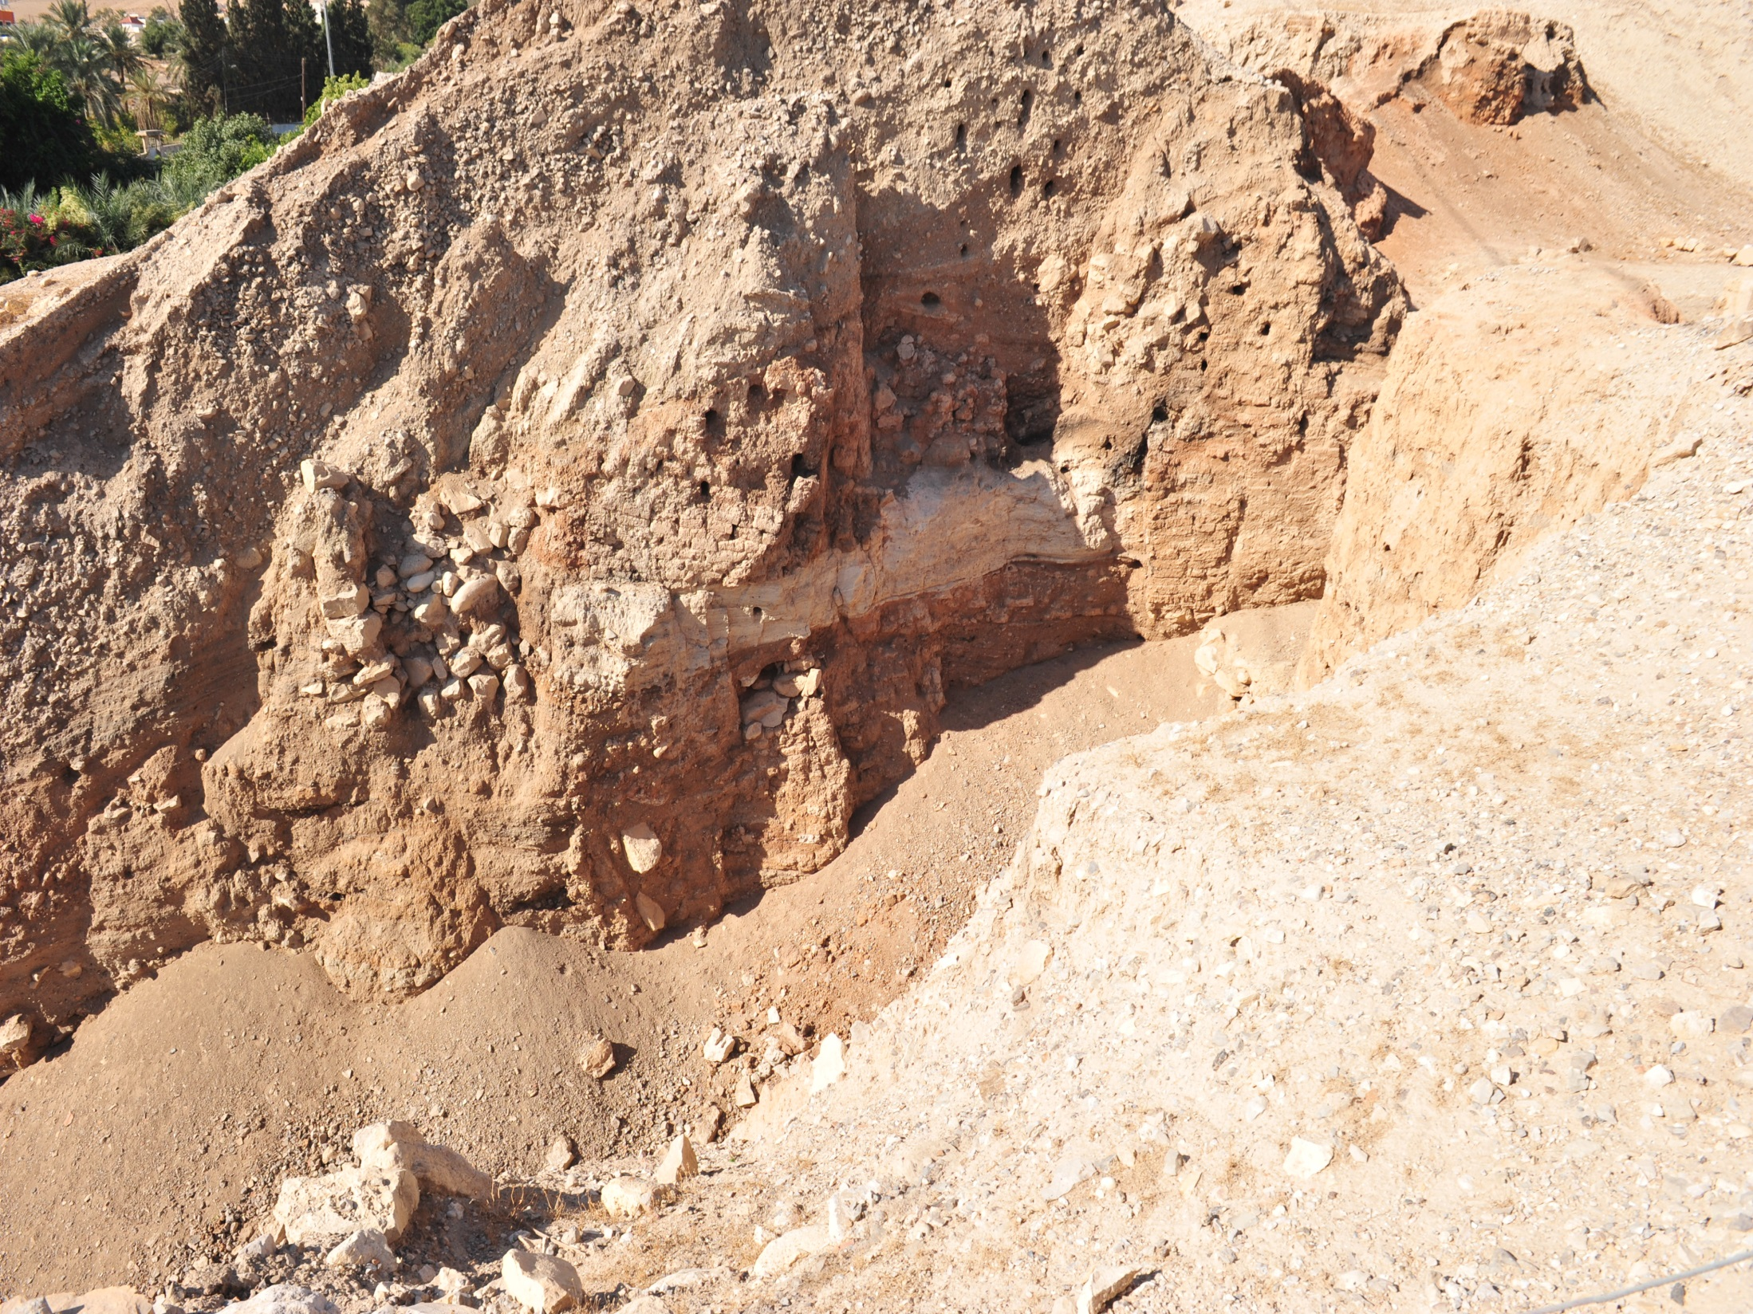
Joshua Texts
There are some additions in the LXX that reflect Hebraistic diction that can be easily retroverted back into Hebrew.
Tov concludes "the MT and LXX do not reflect textual differences, but rather two different editions of the book....the edition of the MT expanded the shorter one reflected in the LXX (The Greek and Hebrew Bible, 1999, p. 395).

Slide 50
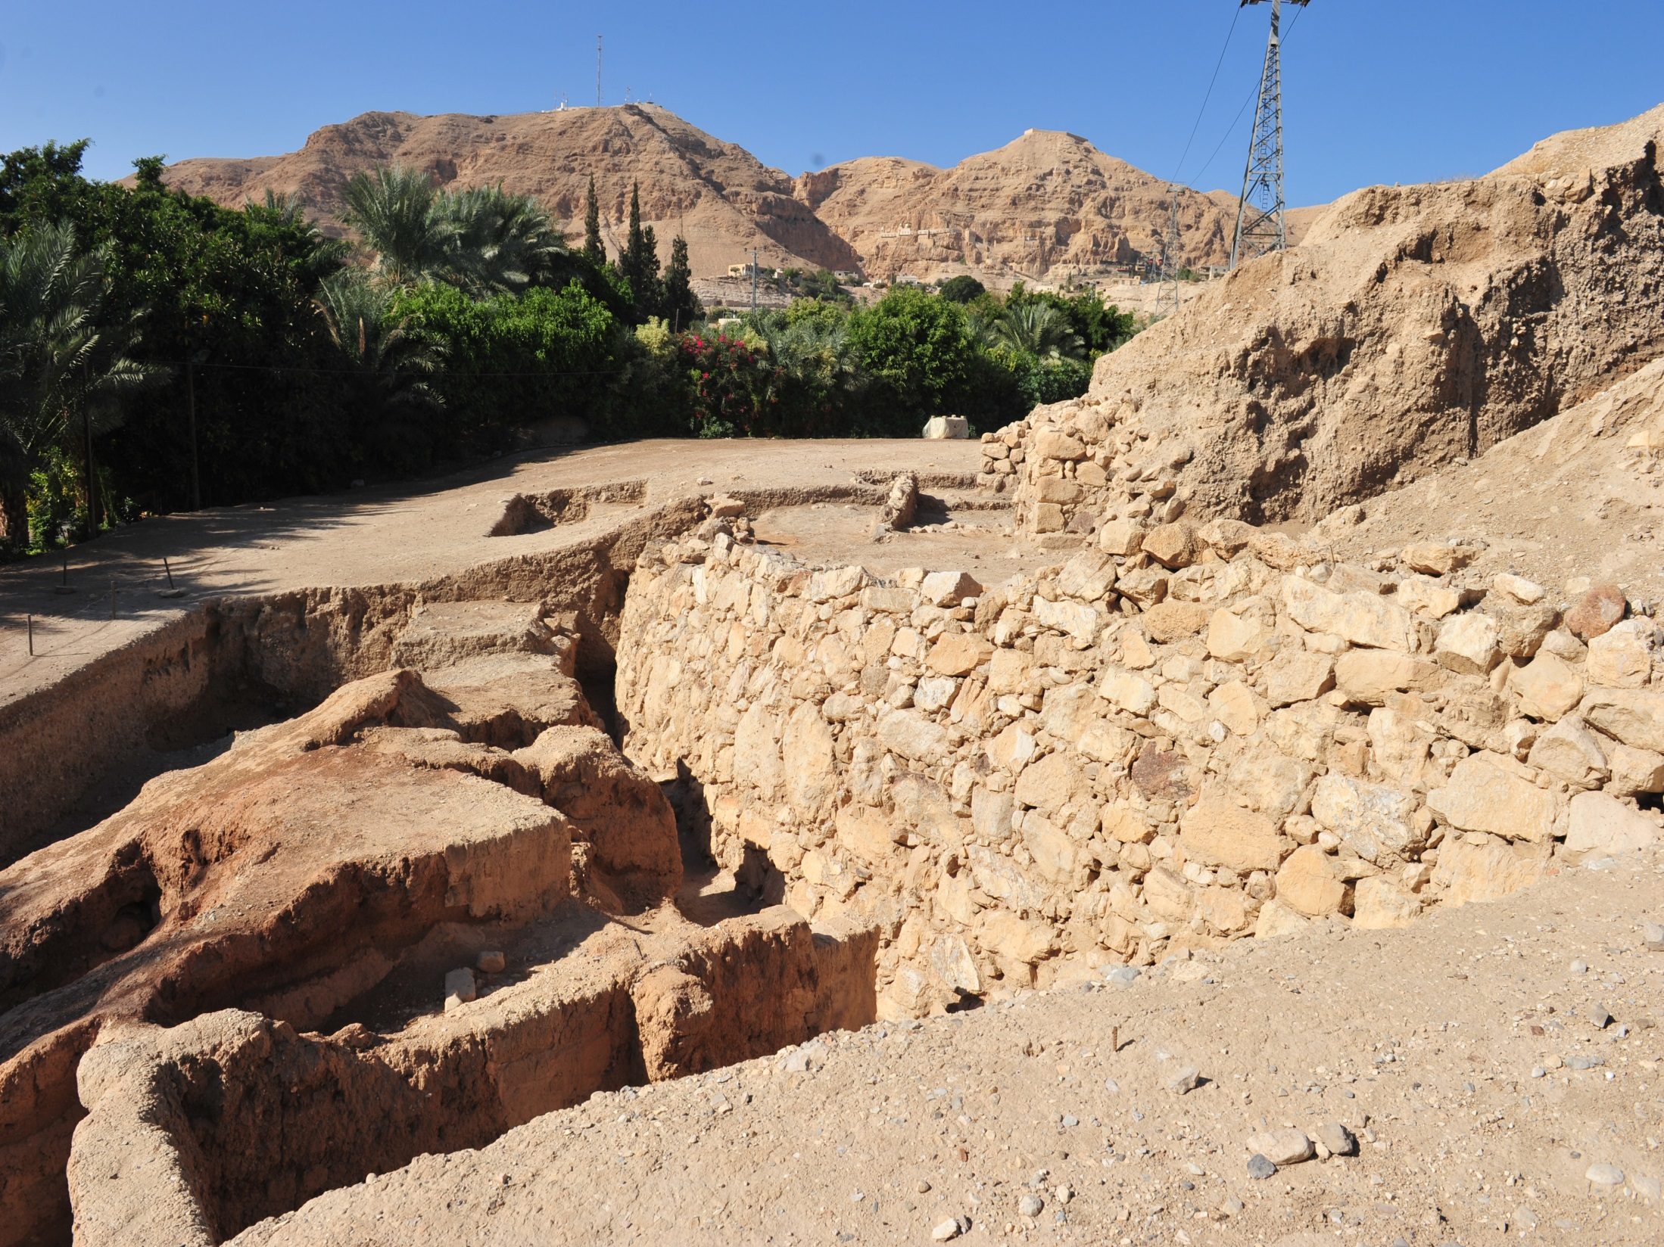
Joshua Texts
4QJosh(a) presents a more earlier version of Joshua than MT & LXX. MT is long, LXX is shorter, & 4QJosh(a) is the shortest and has a different order of narratives. 4PaleoParaJoshua may be yet another edition. Joshua 8:30-35 may once have belonged elsewhere, and Mount Gerizim was changed to Mt. Ebal.
Jericho

Slide 51
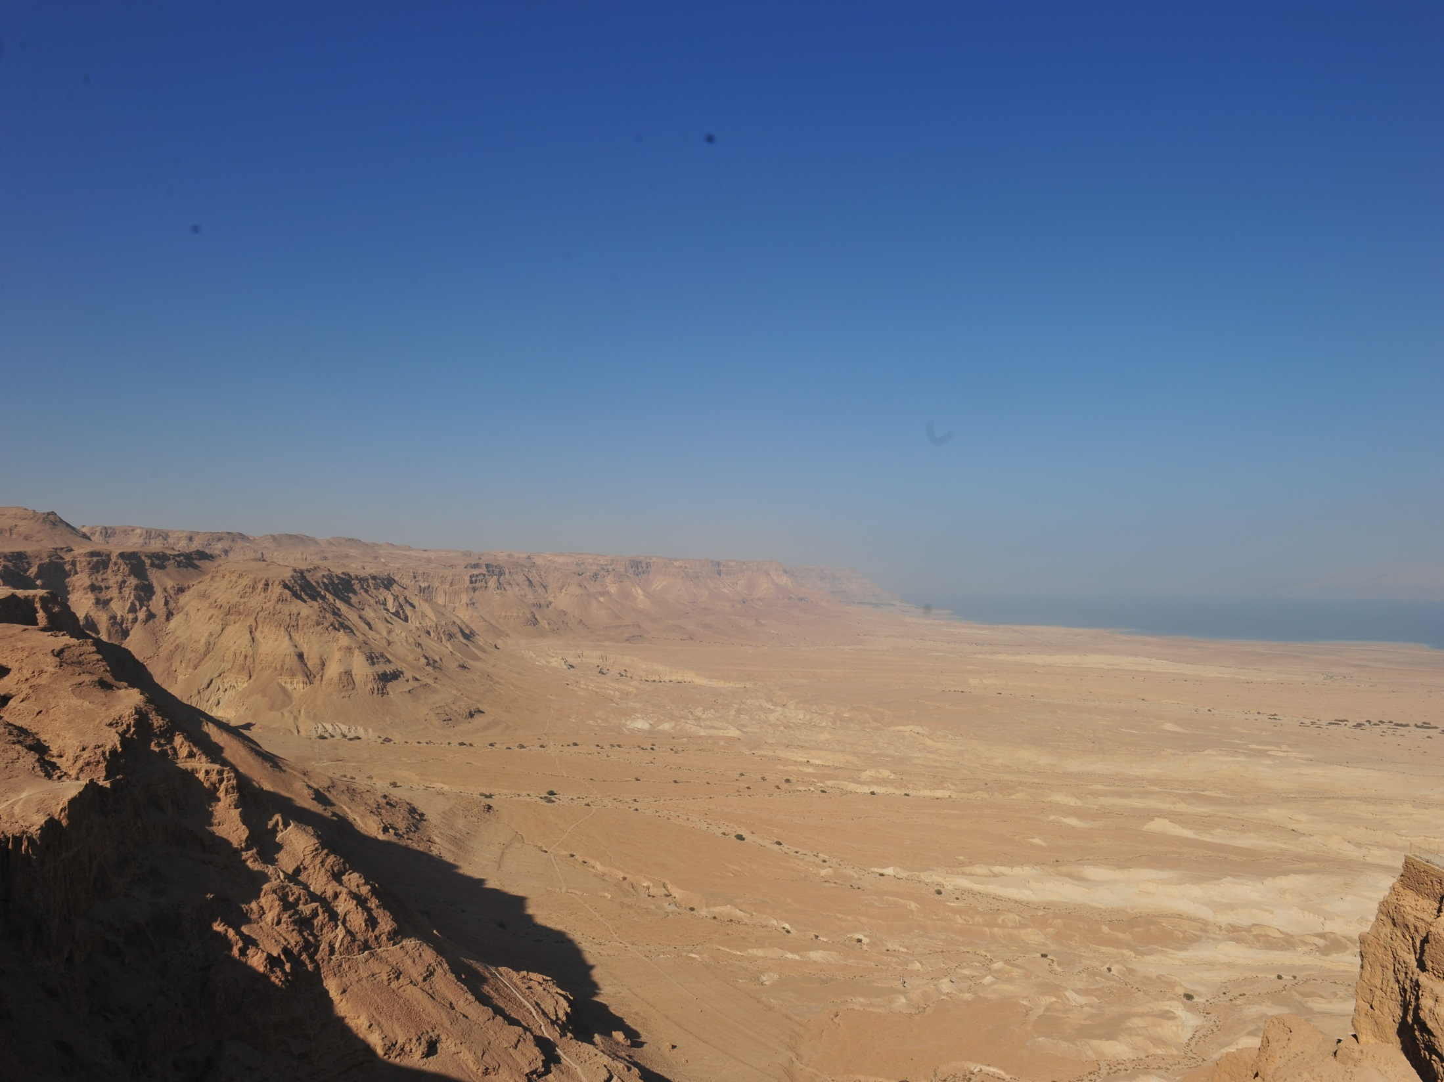
Judges DSS Texts
4QJudg(a) is an earlier text that is shorter than the Masoretic Text and the Septuagint Text. Most likely the theological passage of Judges 6:7-10 was inserted in much later versions. A. Rofe research suggested that the addition after Joshua 24:33 reflects an earlier and more original development were Joshua and Judges were combined together. The end of Joshua is followed by Judges 3 with the first two chapters of Judges added later.
View from Masada

Slide 52
Samuel texts
The Dead Sea Scroll 4QSamª is very close to the readings of the LXX, and Josephus against the MT. See The Qumran Text of Samuel and Josephus by E.Ch. Ulrich, 1978. Josephus' text is based on the Greek rather than the Hebrew text of the Old Testament.
There is a very literal translation in the LXX of the Hebrew section of 2 Samuel 10-1Kings 2:11 which is called kaige-Th. Other sections are not that literal. There are 124 times where 4QSamª equals the LXX, and does not equal the MT in the non-kaige-Th section, but only 20 times in the kaige-Th section. It seems that the kaige-Th section contains a revised Greek text.

Slide 53
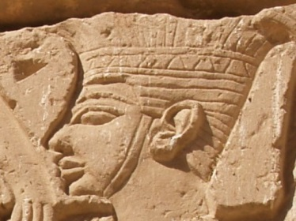
Samuel texts
One key section 4QSamª (and the LXX) is different from the MT is in I Samuel 16-18. The 4QSamª and the LXX say that Goliath is only 4 cubits and a span tall ( 6’ 9”) while the MT says 6 cubits and a span tall (9’9”). It seems that the MT is the juxtaposition of two separate accounts of these events about David and Goliath (Tov, 1999, 354).
Philistine head

Slide 54
Samuel texts
Traditional I Samuel and 2 Samuel were considered one book. They are together on the same scroll, 4QSam(a).
One of the most dramatic discoveries in the DSS was a three and half line paragraph that was missing from the Masoretic Text and LXX. Josephus does have it. Some new versions include this paragraph in the Bible. It comes right before I Samuel 11. It helps explain the story about Nahash the Ammonite. It states,
Nahash king of the Ammonites oppressed the Gadites and the Reubenites viciously. He put out the right eye of all of them and brought fear and trembling on Israel. Not one of the Israelites in the region beyond the Jordan remained whose right eye Nahash king of the Ammonites did not put out, except seven thousand men who escaped from the Ammonites and went to Jabesh-gilead (Dead Sea Scroll Bible, 225).

Slide 55
I & II Kings DSS texts
I & II Kings form one book in the Hebrew Bible. Only three manuscripts of Kings were found at Qumran. The oldest of these are 5QKings and pap6QKings. I Kings 8:16 4QKings preserves a passage that has been lost from the Masoretic Text when a scribe skipped from one phrase to a similar phrase. I Kings 8:16 missing phrase in italics:
“From the day I brought my people Israel out from Egypt, I have not chosen a city from among the tribes of Israel to build a house for my name to there, nor did I choose any one to be a leader over my people Israel, but I have chosen Jerusalem for my name to be there,
And I have chosen David to be over my people, over Israel.”

Slide 56
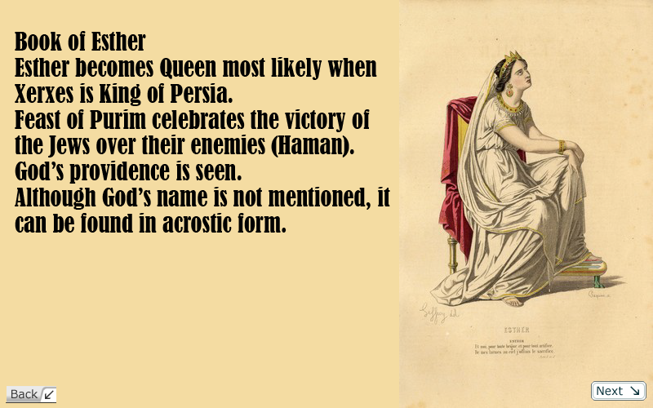
The Book of Esther is not found among the Dead Sea Scrolls. The Qumran community did not celebrate the Feast of Purim in the Book of Esther. The Book of Esther was rejected by the Qumran community for theological reasons.

Slide 57
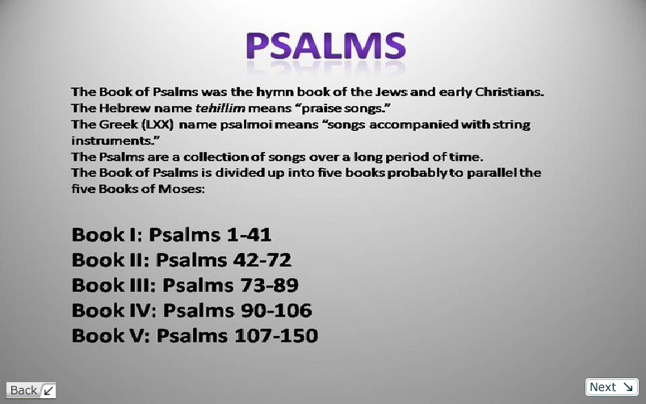

Slide 58
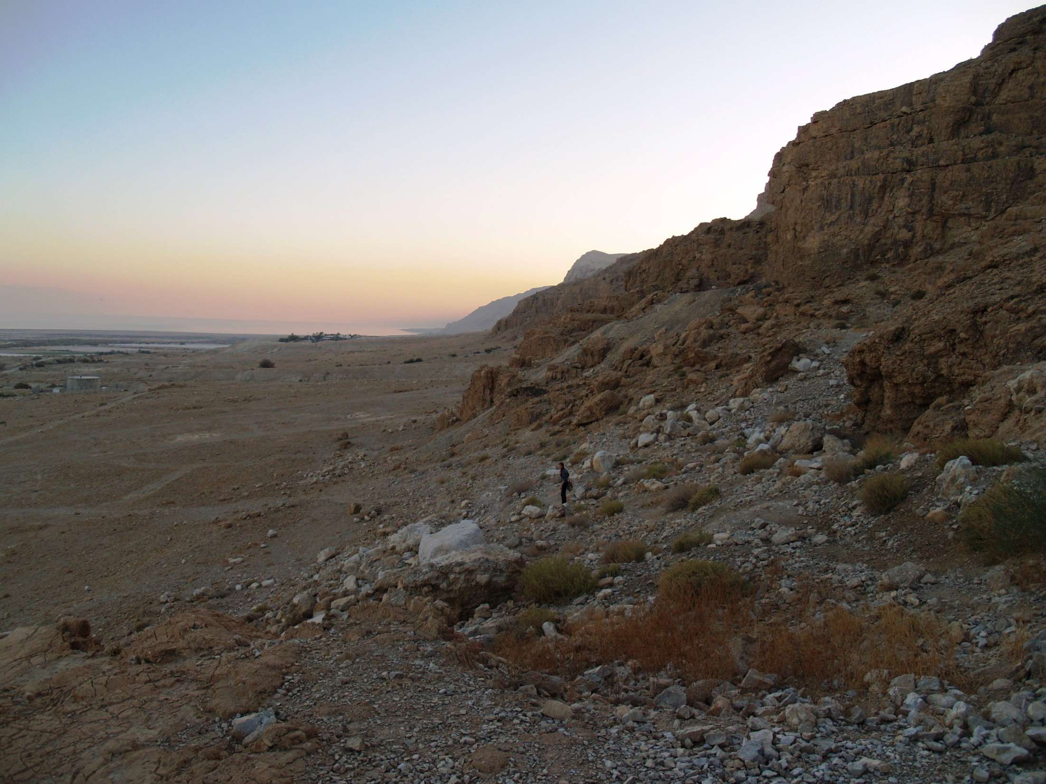
Psalms dss texts
In the Dead Sea Scrolls there is a different arrangement of psalms after Psalm 91. The Great Psalms Scroll from Cave 11 is evidence of this (11QPs(a)). There is some disagreement among scholars whether the Great Psalm Scroll is just an earlier form of the Masoretic Text, or a genuine different edition.
There are a dozen key readings in the DSS Psalms that add new insights and clear up the MT. A missing verse has been found in Psalm 145. Psalm 145 is an alphabetical acrostic. Each verse begins with a successive letter of the Hebrew alphabet, yet one letter (nun) is missing. The Great Psalm Scroll (& the LXX) preserves the missing verse which states, “God is faithful in his words, and gracious in all his deeds.”
View near Cave 11

Slide 59
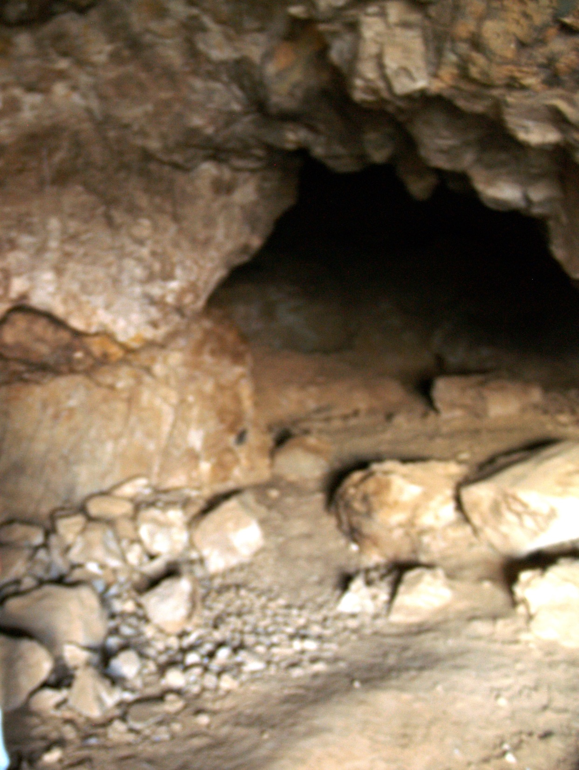
Psalm 22:16
Psalm 22:16 says, “For dogs have surrounded me, the assembly of the wicked have encompassed me, like a lion are my hands and my feet.” The gospels and LXX say, “they have pierced my hands and my feet.” The different reading is all due to one Hebrew word. The Psalm scroll from Nahal Hever (5/6HevPs) reads, “They have pierced my hands and feet.”
Inside Cave 11

Slide 60
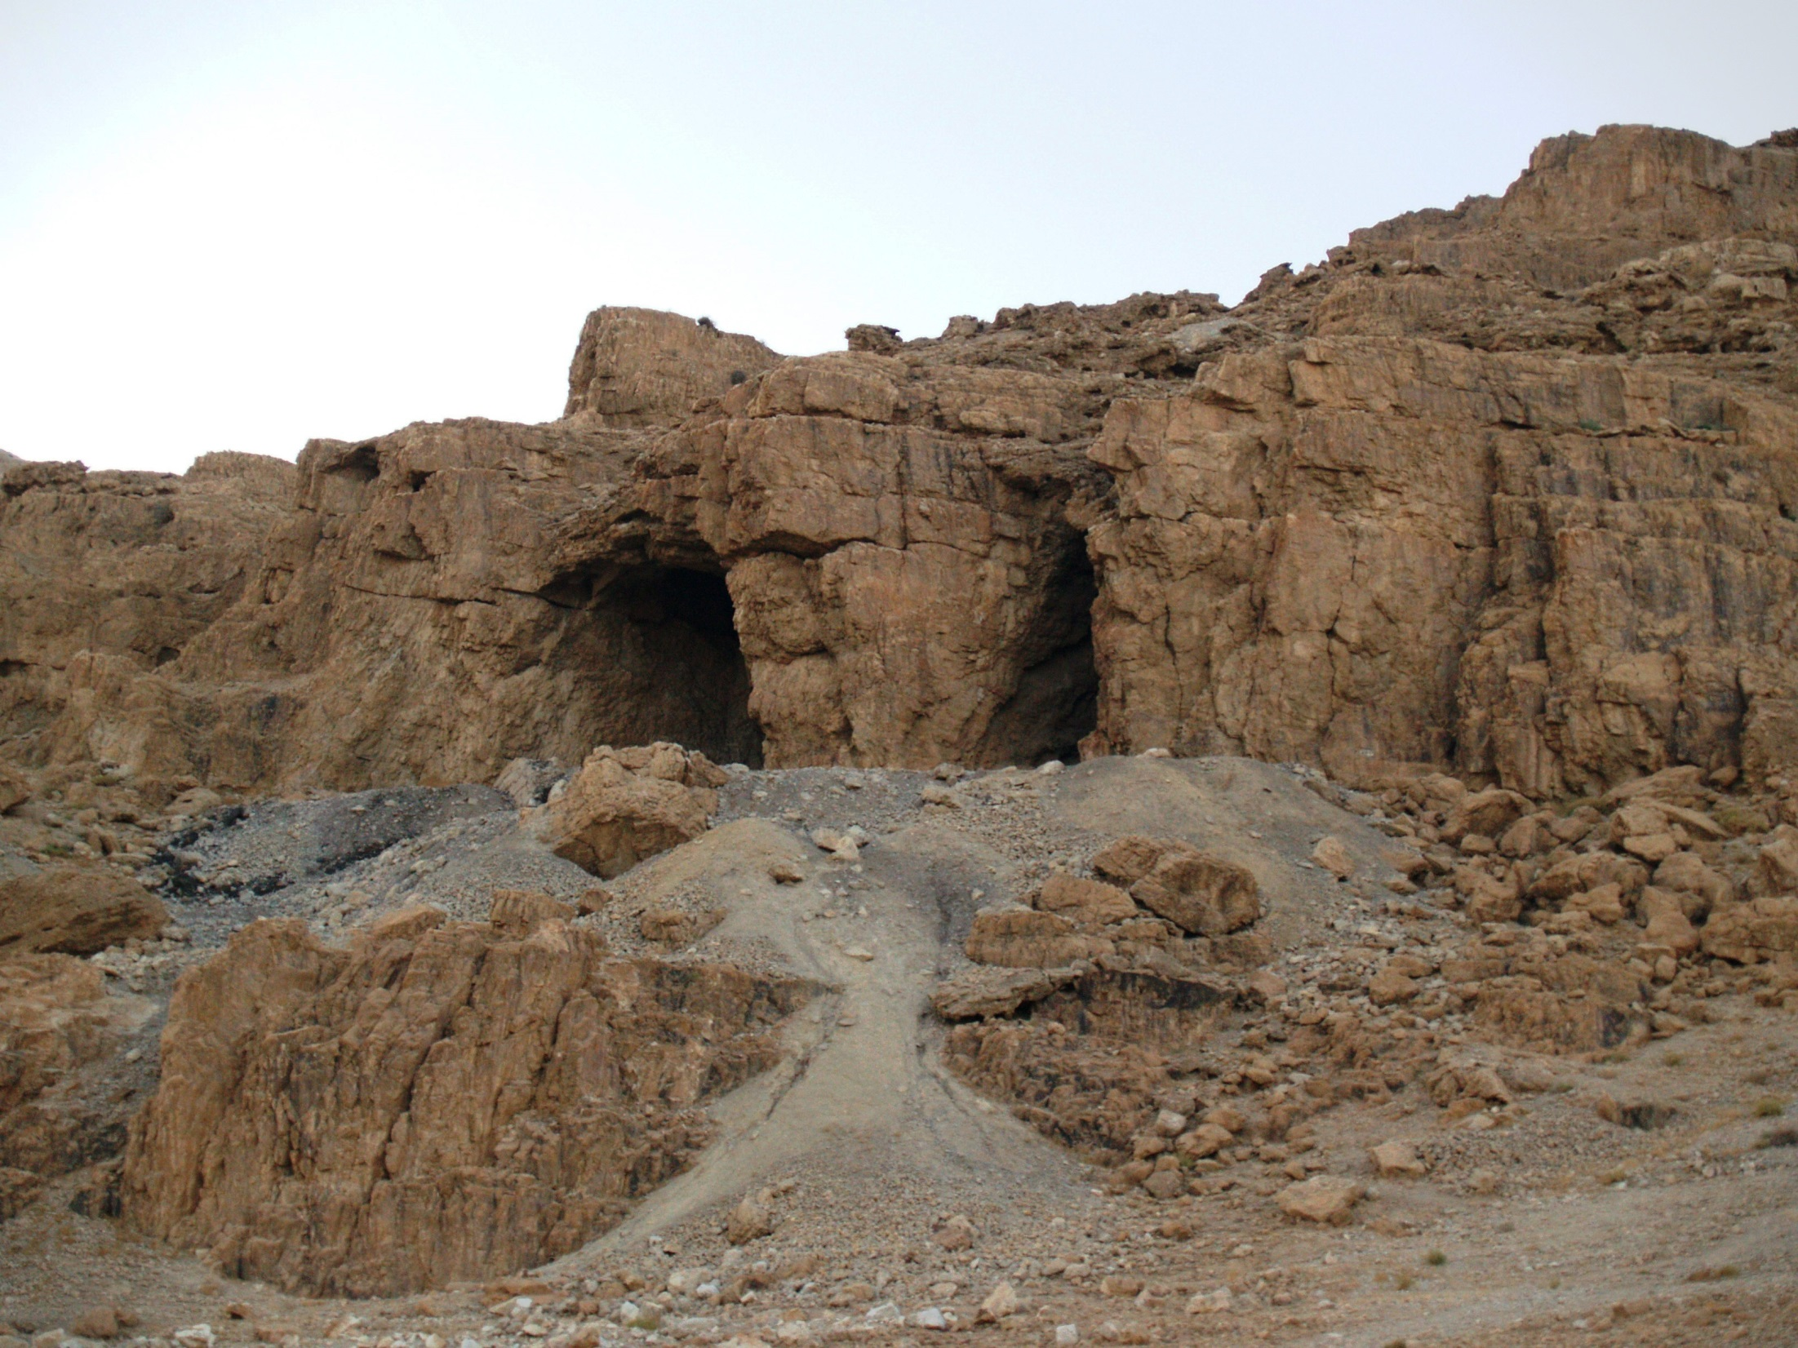
10 New Psalms discovered!
They are: Apostrophe to Zion, Eschatological Hymn, Apostrophe to Judah, the Catena, David’s compositions, the Hymn to the Creator, the Plea for Deliverance, and Three Songs Against Demons.
Near Cave 11

Slide 61
Proverbs: While there are differences between the LXX and the MT, not all the differences can be blamed on the translators.
There are major differences that seem to be from a different Hebrew Vorlage(edition).
For example, there are major differences in the transposition of verses and whole groups of verses.
In Chapters 15 and 16 there are the a number of verses rearranged.
The same is true in chapters 17 and 20. The LXX is shorter than the MT in a number of places (9:1-2, 18:23-24, 20:14-19).
The LXX of Proverbs preserves a different editorial stage than the one found in the MT.
Differences in Sequence of Proverbs
Masoretic Text | Septuagint Text
I. 1:1-9:18, Solomon | I-III 1:1-24:1-22
II. 10:1-22:16, Solomon | VI, A 30:1-14 Agur
III. 22:17-24:22, the wise | IV 24:23-34 also the wise
IV 24:23-34, also the wise | VI, B 30:15-33 Agur
V 25-29, men of Hezekiah | VII 31:1-9 Lemuel
VI 30, words of Agur | V 25-29 men of Hezekiah
VII 31:1-9 Lemuel | VIII 31:10-31 Acrostic
VIII 31:10-31 Acrostic

Slide 62

The Great Isaiah scroll
The magnificent Isaiah scroll generally follows the Masoretic Text (MT), but there are about 1,375 differences from the MT. These variants are of great interest to scholars. The variants fall into four different kinds.
Major variants that have one or more verse changes.
Scribal errors in copying the text.
Minor variants like spelling differences, singular or plural and word order.
Single word changes. One example is Isaiah 53:11 “He shall see of the travail of his soul” is changed to “out of the suffering of his soul he will see light.” One word “light” is added.

Slide 63
The Isaiah scroll
The Qumran community understood Isaiah’s prophecy as relating to their departure into the wilderness in order to prepare the way of the Lord through the study of the Torah. Some think that John the Baptist once studied at Qumran.
'Ghostwriting' the Torah? New algorithm distinguishes contributors to the Old Testament with high accuracy, says Tel Aviv University research. The book of Isaiah is largely thought to have been written by two distinct authors, with the second author taking over after Chapter 39. The software's results agreed that the book might have two authors, but suggested the second author's section actually began six chapters earlier, in Chapter 33."

Slide 64
Jeremiah
Jeremiah is one seventh shorter in the LXX than in the MT. This is the most dramatic difference between the LXX and MT. The LXX of Jeremiah probably reflects an earlier edition of the Book of Jeremiah. Not only is the LXX shorter, but the arrangement of verses is different.
The Dead Sea Scrolls 4QJer^{b,d} are very similar to the LXX with the shorter text, and the different arrangement of verses.
In chapters 27-29 of the MT of Jeremiah the king of Babylon is spelled Nebuchadnezzar while in the rest of the book it is in its original form Nebuchadrezzar. The LXX only has Nebuchadrezzar.
It should be noted that pseudepigraphal writings, and revisions were a common practice in ancient times. Their view of inspiration was also very different.
The MT editor added headings to prophecies, repeated sections, added new verses and sections, new details, new arrangements, and clarification of unclear passages. This most likely done after the exile.
In the LXX Jeremiah chapters 46-51 of the MT follow 25:13 of the LXX. These oracles against the nations are also put in a different order.

Slide 65
Ezekiel
There are many differences between the LXX and MT of Ezekiel. The LXX of Ezekiel is about 4-5% shorter than the MT. One example is Ezekiel 7:3-9. The LXX of Ezekiel seems to reflect a shorter Hebrew text. The MT being a later expanded edition. The MT adds parallel words and phrases, exegetical phrases, harmonization, and new material.
Ezekiel 36 is longer in the MT. P. Chester Beatty 967 of the LXX lacks verses 23-38. This implies that the Old Greek reflects an early stage of development of the Book of Ezekiel.
11QEzek also may have had a shorter text than the MT.

Slide 66
Daniel DSS Texts
Seven of the eight scrolls contained the whole Book of Daniel in shorter form like the MT over against the longer LXX.
4QDanb says “he wrote down the (dream)” with no room for the longer “he related the sum of the words” in Daniel 7:1.
In Daniel 10:16 which reads, “one like the sons of man” is changed to “something in the form of a human hand” (like the LXX).

Slide 67

Daniel DSS Texts
4QPrayer of Nabonidus (4Q242) may be pre-Danielic traditions in the DSS. Even before the the discovery of the DSS, Wolfram von Soden suggested that the stories about Nebuchadnezzar in Daniel 3 and 4 actually came from legends about Nabonidus.
Nabonidus Cylinder
4Q242 starts, “the words of the prayer which Nabunay(Nabonidus) king of Babylon prayed.” Nabonidus gives an acccount of his evil skin disease suffered by the decree of God for a period of seven years in Taiman then healed by the agency of a Jew. Neo-babylonian inscriptions also confirm that Nabonidus had an illness and stayed in Taiman for a period of time. It seems that the lesser known name Nabonidus was replaced by the well-known Nebuchadnezzar in the Book of Daniel.
4QBook of Giants (4Q530 15-20) and Daniel 7:9-10, 28 are very similar. The Book of Giants seems to be an older tradition than Daniel.

Slide 68

Gospel in the Dead Sea Scroll 7Q5?
Among the Dead Sea scrolls, 7Q5 is the designation for a small papyrus fragment discovered in Qumran Cave 7. The significance of this fragment is derived from an argument made by Jose O´Callaghan in his work ¿Papiros neotestamentarios en la cueva 7 de Qumrân? ("New Testament Papyri in Cave 7 at Qumran?") in 1972, later reasserted and expanded by German scholar Carsten Peter Thiede in his work The Earliest Gospel Manuscript? in 1982. The assertion is that the previously unidentified 7Q5 is actually a fragment of the Gospel of Mark, chapter 6 verse 52-53. The majority of scholars have not been convinced by O'Callaghan's and Thiede's identification and it is "now virtually universally rejected". (Wikipedia)

Slide 69
Three major Editions
Of the old testament
Palestine
Babylon
Egypt
Samaritan Pentateuch
Septuagint
Masoretic Text

Slide 70
Conclusions
From the study of the Dead Sea Scrolls we can see a lot of fluidity in the transmission of the Biblical texts. Not until the Council Jamnia in 90 AD did the Old Testament become fixed.
The use of the Dead Sea Scrolls is like a two-edged sword that cut both ways. It shows how accurately the Old Testament has been copied over thousands of years. It also shows that there have been changes. Some words, phrases, and verses have been both omitted and added.
For some books of the Old Testament there are different editions. Most notably is the Book of Jeremiah in the LXX which is 1/7th shorter that the MT.
There are three major editions to the Old Testament: the Babylonian Masoretic Text (MT), the Egyptian Septuagint (LXX), and the Palestinian Samaritan Pentateuch (SP) all of which are found among the Dead Sea Scrolls.

Slide 71
Key Resourses
Textbook for this course is The Meaning of the Dead Sea Scrolls by James VanderKam & Peter Flint.

Slide 72
This is an excellent book with translations of the Bible from the Dead Sea Scrolls. Differences are italicized. The Dead Sea Scrolls Bible translated by Abegg, Flint, and Ulrich. Published by HaperSanFranciso, 1999

Slide 73

Textual Criticism of the Hebrew Bible by Emanuel Tov.
This is an excellent book, but may be difficult for those with no background in this.

Slide 74

This is an excellent book showing the impact of the Dead Sea Scrolls on the New Testament.

Slide 75

Another excellent book edited by Peter Flint.

Slide 76
Dead Sea Scrolls
Congratulations!
You have completed this course.
By
Dr. Stephen C Meyers
Institute for Biblical & Scientific Studies
www.bibleandscience.com

